Slide 1




Capacity Building for Solar Energy Use
Introduction to the
German Solar Academy Network (GSAN)
Solar Quality Awareness Raising, Know-how Transfer
and Business Matchmaking
PV-Projects Agency, Berlin
Matthias Raab, Managing Director
20th WIPRO Conference
December 11, 2024, Dresden, Germany
Projects for Sustainable Development – Global Marketing of Photovoltaics www.pv-pa.com

Slide 2
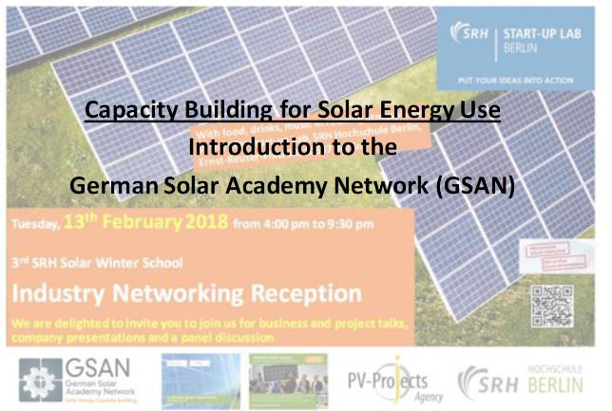
Projects for Sustainable Development – Global Marketing of Photovoltaics www.pv-pa.com

Slide 3
Contents
Introduction to PV-Projects Agency and SRH Hochschule Berlin
Challenges and Solutions: the Energy Situation in Less-dev. Countries (ex. TZ)
International Vocational Training Programs for Capacity Building
4. SRH Solar Winter and Summer Schools, Wind Industry Training in Berlin
5. The German Solar Academy Network (GSAN)
Projects for Sustainable Development – Global Marketing of Photovoltaics www.pv-pa.com

Slide 4
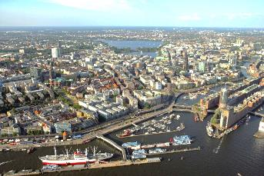
The PV-Projects Agency (PV-PA)
Independent Berlin/Hamburg-based service company for consultancy and project development
in the field of renewable energies, energy efficiency and sustainable development.
Established in 2009.
Focus on further dissemination of Solar Energy Use in especially “off-grid” areas (rural electrification)
“New/attractive markets” opener for the Solar Industry
Main target regions: “LDC’s”, Africa (sub-sahara), Asia, e.g.: Ghana, Cameroon, Tanzania, Madagascar, Pakistan, Indonesia, India
Projects for Sustainable Development – Global Marketing of Photovoltaics www.pv-pa.com

Slide 5

PV-PA‘s Activities: „a 4-pillar based Approach“
Vocational Training and Education
    Conceptualization and conduction of (innovative) training programs in Berlin and in target countries
    Implementation of solar Vocational Training Centers („Solar VTC‘s“)
Technology Demonstration Projects abroad:
    A) “Light House” projects, e.g. dena RES program
    B) Solar, RE, Water Resource Management and Eco Technology Park in
    Kilimanjaro district to show use and benefits also to decision makers (“Vision”)
Research
    ..on the „implementation of innovative financing models for PV in low-income regions“
    with students and experts from the SRH/PV-PA’s network.
Marketing Advisory and Sales of Products
Projects for Sustainable Development – Global Marketing of Photovoltaics www.pv-pa.com

Slide 6
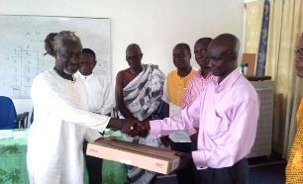
PV-PA‘s Services – a great Asset to its Clients
Who are our clients/partners ?
  private sector (end customers*, solar companies, trainees),
  Governmental Organizations, NGO’s, communities,
  educational institutions, banks
  *end customers: hotels, hospitals, farmers, urban and rural
  households
Concerned about high quality of products and services:
focus on reliable state-of-the-art technology/products/services,
cooperation with reputable system and component providers only,
reasonably priced, with strong after-sales service.
“PV-Projects” holds excellent expertise in photovoltaics and great contacts to important players (organizations, financing institutions, R&D) for strategical cooperation
Projects for Sustainable Development – Global Marketing of Photovoltaics www.pv-pa.com

Slide 7
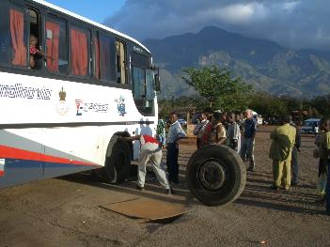
Energy, Development, Challenges in Tanzania
Situation:
Politically stable
Good economic growth
Energy blackouts
Off-grid solutions are of interest
Highly dispersed population
The market starts to grow
Challenges:
PV components difficult to get
Lack of experts for installation and maintenance and marketing/sales
Financing concepts
Projects for Sustainable Development – Global Marketing of Photovoltaics www.pv-pa.com

Slide 8
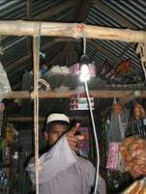
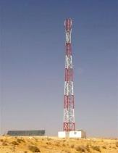
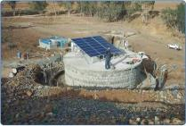
One Solution is already in Place, it‘s called PV..
In remote areas PV allows to
  .. light up homes and bring modern communication to remote villages
  .. supply small enterprises, health centres and schools with power
  .. improve farming and self-supply
  .. create local job opportunities (business)
  .. improve social conditions
  etc.
Different solutions:
  Solar Home Systems and stand-alone systems for buildings and other facilities
  PV (supported) mini-grids for communities
Projects for Sustainable Development – Global Marketing of Photovoltaics www.pv-pa.com

Slide 9
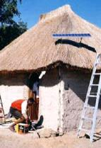
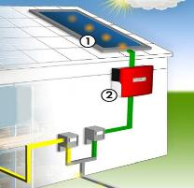
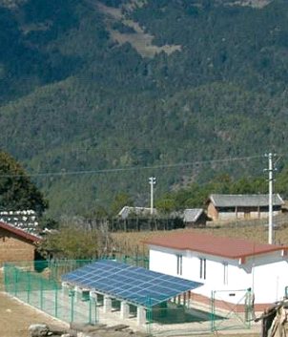
Solar Electricity Solutions
9
Solar Home Systems /
Stand alone systems
Supply of single buildings
and remote area applications
to cover the basic needs:
light, communication, TV
minimum power for
single buildings and systems
Micro/Mini Grid
Supply of a few homes
up to whole villages with
solar/renewable energy
full electricity supply
for rural areas
Grid-connected
systems
Electricity is directly fed
into the public grid
if the public grid is
within reach (backup)
11/08/2009
© BSW-Solar

Slide 10
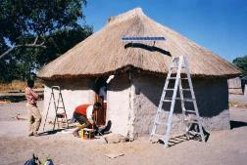
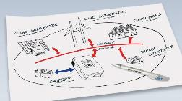
...with a lot of advantages ☺....!
Independence from the public grid (instabilities) and other fuels
System size can easily be adapted to user/community needs
Combination of RE and conventional technologies possible
Often a very cost-competitive solution
Long lasting solution
Low maintenance costs
No pollution/noise
No costly grid extension necessary
Projects for Sustainable Development – Global Marketing of Photovoltaics www.pv-pa.com

Slide 11
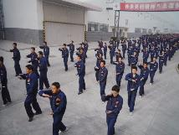
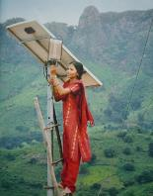
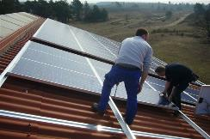
But unfortunately ..a lack of experts ☹....!
-> What is needed is…
Manpower, skilled people inside the markets (“close” to the
customer) that are able to cooperate/work with solar
system providers and/or component manufacturers
Sales and Marketing know-how is necessary (incl. the last mile)
Business skills (accounting, logistics, project planning and financing)
And above all installation personnel
Reliable, capable, efficient and
effective (interesting) partners
for international active or
(bigger) national solar companies
Projects for Sustainable Development – Global Marketing of Photovoltaics www.pv-pa.com

Slide 12
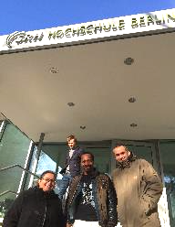

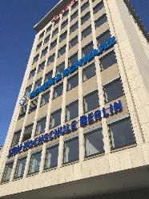

Capacity Building
PV-PA is partner of the International Institute for Sustainability Management (IISM)
at SRH Hochschule Berlin
Main focus on (intensive) vocational training - nationally and internationally
Education is Key! www.pv-pa.com

Slide 13
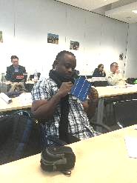
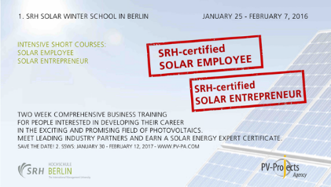
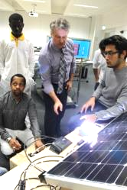
In Germany
„The international Solar Employee/Entrepreneur (TiSE/E)“ Program of PV-Projects Agency in cooperation with SRH Hochschule Berlin
1st SRH Solar Winter School (1.SSWS) Jan/Feb 2016 in Berlin
Education is Key! www.pv-pa.com

Slide 14
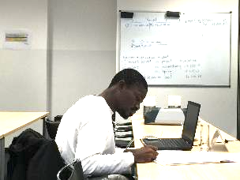
SRH Solar Winter School
„The international Solar Entrepreneur/Employee“ (SRH-certified)
Max. 6 weeks program (2 weeks in Berlin + online preparation + internship, matchmaking with
German Solar companies)
Strong practice-oriented focus on the direct development of sales channels and
economic results
The teaching is concise, clear, relevant for daily practice and good business, certified
Individuals with engineering, business or commercial background
Working professionals employed in a solar company or freelancing in the solar field, renewable energies students and recent graduates
Education is Key! www.pv-pa.com

Slide 15
Matchmaking
10.12.24
15
www.phaesun.com

Slide 16








With Leading Industry Partners
Innovative, intensive Vocational Training Course from Industry and Academia
Essential Business Know-how Transfer for Future Solar Employees and Entrepreneurs
Strong Practice-oriented Focus on the direct Development of
Sales Channels and Economic Results
Education is Key! www.pv-pa.com

Slide 17
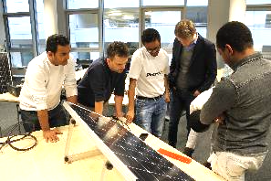
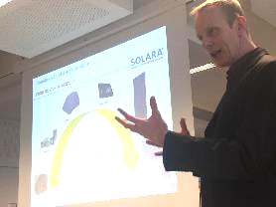
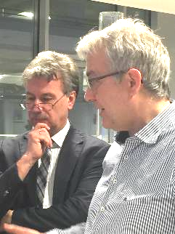
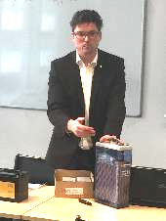
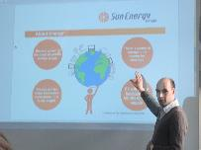
Impressions of the 1st SRH Solar Winter School
Education is Key! www.pv-pa.com

Slide 18
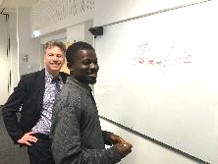
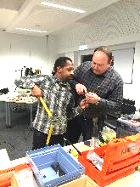
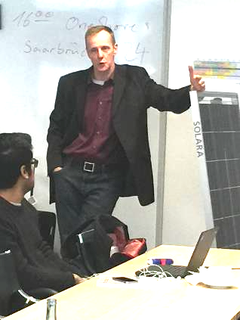
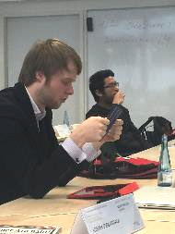
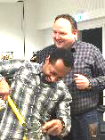
Impressions of the 1st SRH Solar Winter School (ii.)
Education is Key! www.pv-pa.com

Slide 19

Image Film 2.SSWS
https://www.youtube.com/watch?v=lYvYg4jlwnQ
Projects for Sustainable Development – Global Marketing of Photovoltaics www.pv-pa.com

Slide 20
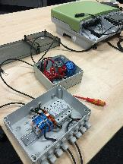
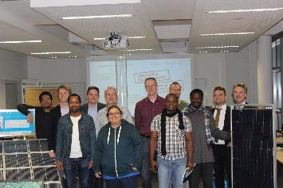
More Images and Updates on Facebook
https://www.facebook.com/solar.business.essentials/?ref=bookmarks
Education is Key! www.pv-pa.com

Slide 21
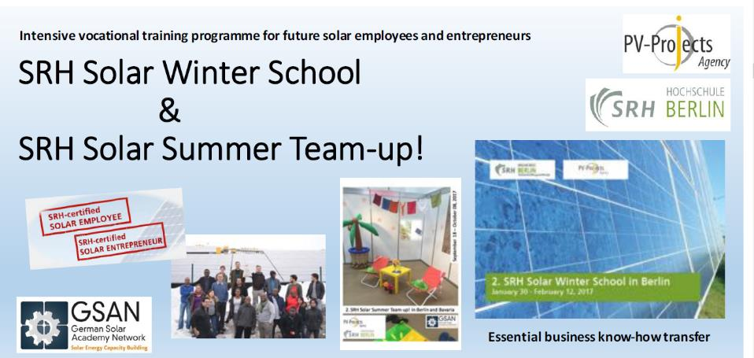
Education is Key! www.pv-pa.com

Slide 22
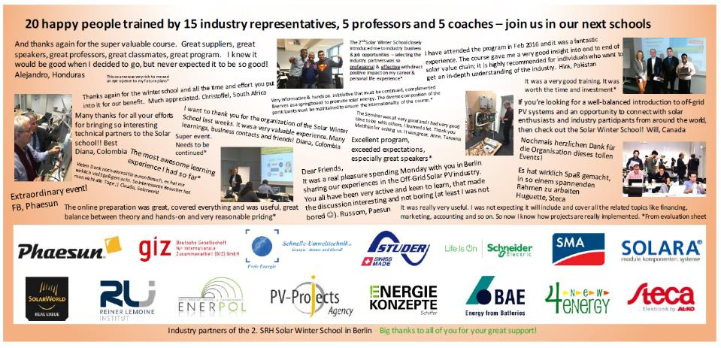
Education is Key! www.pv-pa.com

Slide 23
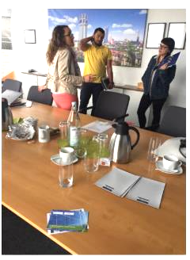
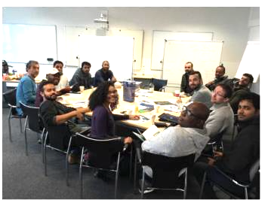
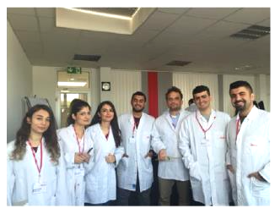
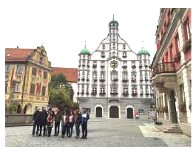
Education is Key! www.pv-pa.com

Slide 24
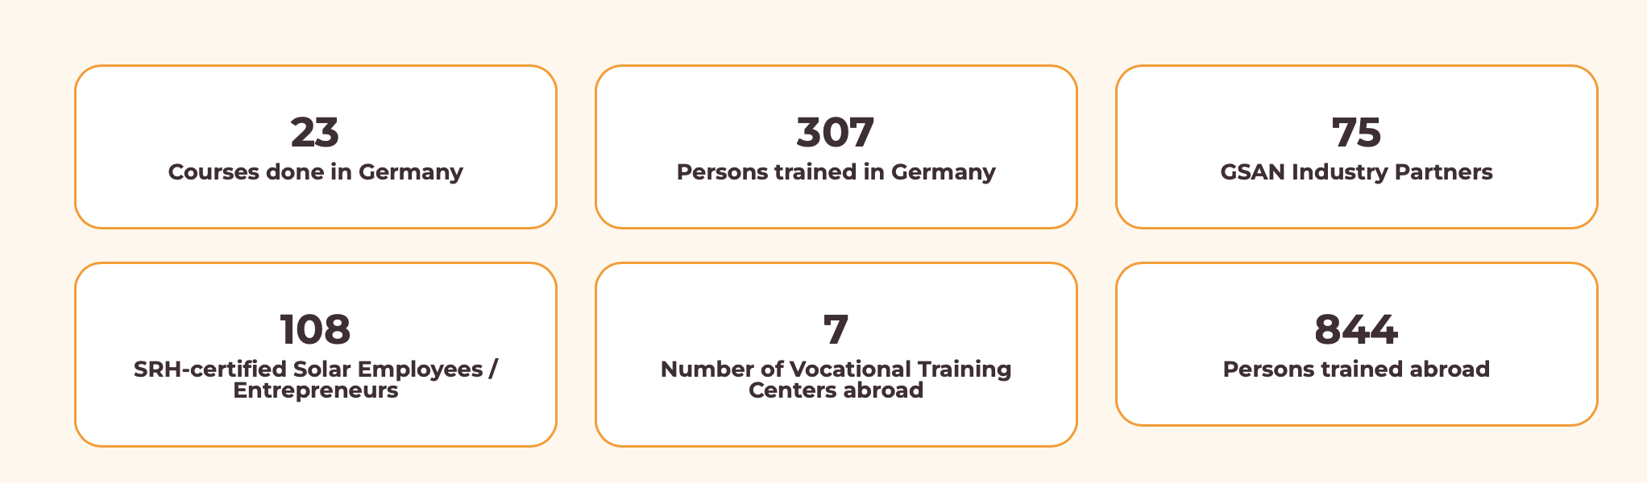
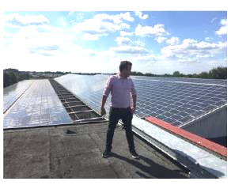
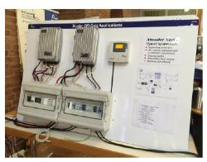
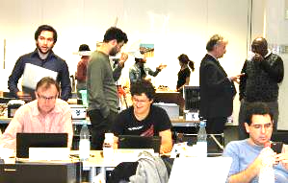
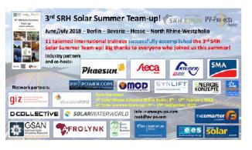
Education is Key! www.pv-pa.com

Slide 25
Benefits for Trainees
Very practice-oriented learning
Efficiency through online preparation
Tight connection to companies, i.e. potential future project partners or employers
Absolutely passionate trainers from university and industry
Pleasant studying at eye level and in alliance
Focus on the essentials for successful business
Plenty of insider tips, advices and practical values
Tools and templates for business use
Reasonably priced and financing help available
Many interesting international trainees
Integration into a strong network from the environment, energy, start-up and innovation sector
Facilitation for engagement and expansion of one’s professional career in a societal important field
Cultural program in Berlin incl. evening receptions
Technical hands-ons and excursions
A variety of exciting, open and target-oriented learning and networking sessions
Education is Key! www.pv-pa.com

Slide 26
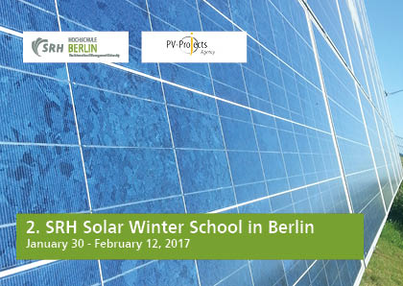
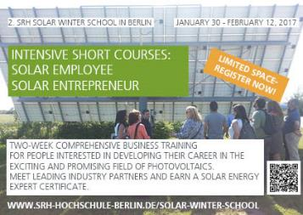
2.SSWS – Application Phase
Education is Key! www.pv-pa.com

Slide 27
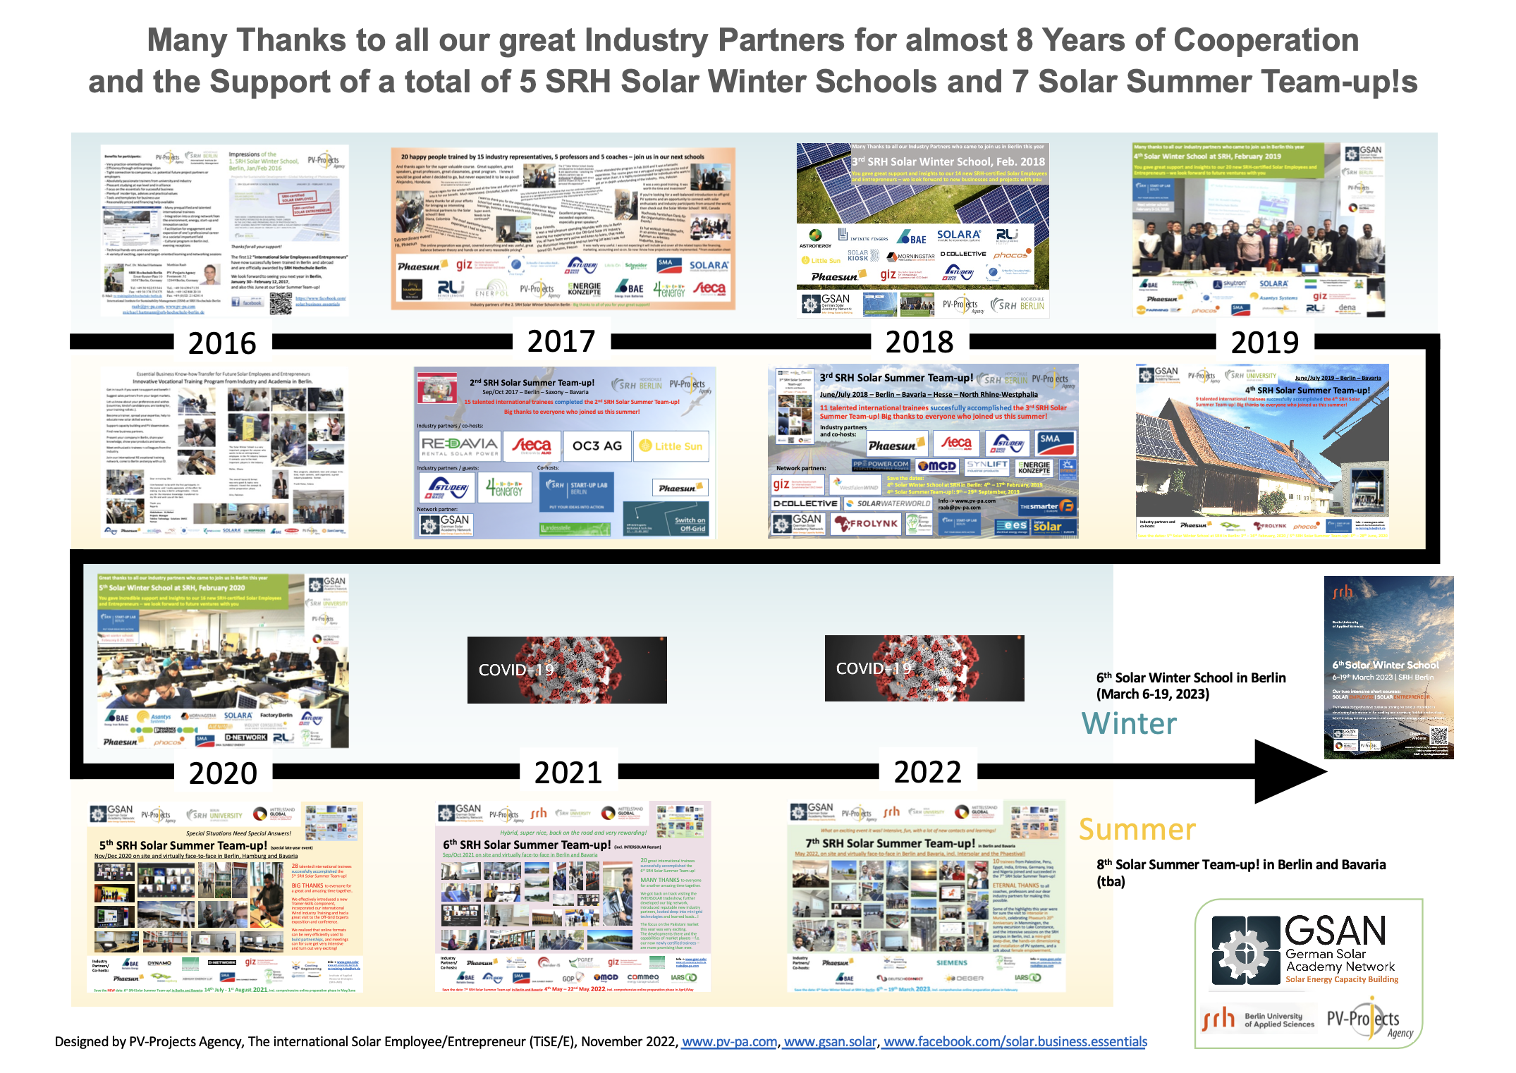
History Solar Winter and Summer Schools
Education is Key! www.pv-pa.com

Slide 28
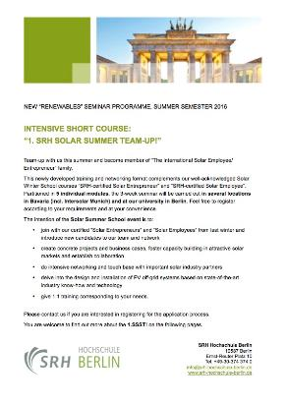
Solar Summer Team-up!
For both Solar Winter and Summer School Ask for Program Descriptions
Resp. follow the SRH Link on the Invitation Flyer or visit www.PV-PA.com
Projects for Sustainable Development – Global Marketing of Photovoltaics www.pv-pa.com

Slide 29
SRH Solar Summer Team-up! 11th June to 1st July 2018
Projects for Sustainable Development – Global Marketing of Photovoltaics www.pv-pa.com

Slide 30

In Target Markets
Export of Dual Vocational Education „Made in Germany“
  Implementation of SRH Solar Vocational Training Centres („S-VTC‘s“)
  and
  SRH Solar Winter School
  („TiSE/E“) „on tour/abroad“
Education is Key! www.pv-pa.com

Slide 31
Implementation of new Solar Competence Hubs
Idea and Concept
Introduction of new short- to long-term training
- Together with vocational training centres („VTCs“) in attractive markets
- Existing VTCs usally deal with topics:
brick laying, auto mechanics, electro-technics
- Expansion starts with photovoltaic off-grid technology
All other RE solutions to follow plus Water Ressource Management
Education is Key! www.pv-pa.com

Slide 32


Bringing the sunshine into more people's lives
Target:
Creation of new competence centres (S-VTC‘s)
for educational, informational and sales purposes
German Partners:
International Institute for Sustainability Management at
SRH University Berlin in partnership
with inside e.V., Landesstelle and PV-Projects Agency (PV-PA)
- Serving the solar industry
Education is Key! www.pv-pa.com

Slide 33
SRH‘s Solar Vocational Training Centres („VTC‘s“) in Ghana
Solar Vocational Training at the Kikam Technical Institute (in Kikam)
KTI is well established for vocational training in mechanics and electrotechniques
50 years of experience
Extension Solar Energy
Solar Vocational Training at the Builders of Today Professional College „BOTA“ (Accra-Tema)
New technical college, registered
Vocational training in photovoltaics
Education is Key! www.pv-pa.com

Slide 34
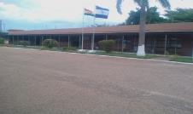
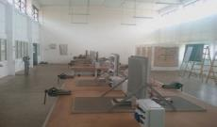



Time Line Kikam
Preparation Phase
2012
SRH visit to Kikam
2013
Training of the Trainers
in Berlin
Education is Key! www.pv-pa.com

Slide 35



Reception of Training Material,
Start of Training
2014-2015
Education is Key! www.pv-pa.com

Slide 36



Installation of Phaesun Training System
2014-2015
September 2015
Education is Key! www.pv-pa.com

Slide 37


Ceremony for the first Graduates
September 2015
Education is Key! www.pv-pa.com

Slide 38


Graduation of the first Batch of Trainees
September 2015
Education is Key! www.pv-pa.com

Slide 39


More Solar VTCs in Cameroon and Tanzania
Vocational Trainings in Yaoundé since May 2015
Prof. Dr. Michael Hartmann (SRH) in Yaoundé at German Solar Academy Cameroon (GSAC) – Start of the first lectures
Education is Key! www.pv-pa.com

Slide 40



German Solar Academy Cameroon (GSAC)
Pictures of the Visit of GSAC Manager Bertrand Pani in Berlin in February and of the start of the first lectures in April 2015
Education is Key! www.pv-pa.com

Slide 41




... Tanzania,
In Search for Partners
HAI Intitute Boma‘ngombe, Kilimanjaro
Visit at HAI Institute, left: Principal Peniel Shali, October 2013
Education is Key! www.pv-pa.com

Slide 42




The Premises of the HAI Institute
Education is Key! www.pv-pa.com

Slide 43

http://gsan.solar/
Projects for Sustainable Development – Global Marketing of Photovoltaics www.pv-pa.com

Slide 44


Vision: Demonstration of Renewable Energy Systems and Usage in
Northern Tanzania
- Building-up several RE demonstrations in the region for policy makers
- Short distance to Kilimanjaro Airport
- Tourism and charitable institutions
- Projects like Mörk Water‘s water
desalination already in place
- Education, plus competence centre!
- Info and sales hub (warehousing)
Projects for Sustainable Development – Global Marketing of Photovoltaics www.pv-pa.com

Slide 45
For Example:
A Solar Market Place
- Showcasing Productive Use of Energy
- Implementation of a Solar Market Place Pilot
- Building up sales structures for BOSS
in the region and country (GHA and TZ)
Introduction of Phaesun‘s BOSS solutions in Tanzania and Ghana
- Importance of teaching entrepreneurship, BOSS concept
Projects for Sustainable Development – Global Marketing of Photovoltaics www.pv-pa.com

Slide 46



Business Opportunities with Solar Systems
(Rural Electrification)
Projects for Sustainable Development – Global Marketing of Photovoltaics www.pv-pa.com

Slide 47


Slide 48


Slide 49




Exhibitions / Demonstrations
Titanic Beach Ghana
Projects for Sustainable Development – Global Marketing of Photovoltaics www.pv-pa.com

Slide 50





Lighthouse Projects
Mbinga, Vincentian Sisters
German Energy Agency GmbH (dena), 2005, Solar Roofs Program
Projects for Sustainable Development – Global Marketing of Photovoltaics www.pv-pa.com

Slide 51

Projects for Sustainable Development – Global Marketing of Photovoltaics www.pv-pa.com

Slide 52

Projects for Sustainable Development – Global Marketing of Photovoltaics www.pv-pa.com

Slide 53


Projects for Sustainable Development – Global Marketing of Photovoltaics www.pv-pa.com

Slide 54


Projects for Sustainable Development – Global Marketing of Photovoltaics www.pv-pa.com

Slide 55

Projects for Sustainable Development – Global Marketing of Photovoltaics www.pv-pa.com

Slide 56



Projects for Sustainable Development – Global Marketing of Photovoltaics www.pv-pa.com

Slide 57

- 6th GSAN international Wind Industry Training (GSAN-iWIT 2025) at SRH Berlin/Hamburg/Husum (hybrid), 12th__19th September 2025
Projects for Sustainable Development – Global Marketing of Photovoltaics www.pv-pa.com

Slide 58

Projects for Sustainable Development – Global Marketing of Photovoltaics www.pv-pa.com

Slide 59



9th SRH Solar Summer Team-up! 2025 in Berlin and Augsburg/Bavaria (hybrid)
22nd October__8th November 2025
Projects for Sustainable Development – Global Marketing of Photovoltaics www.pv-pa.com

Slide 60

Projects for Sustainable Development – Global Marketing of Photovoltaics www.pv-pa.com

Slide 61


Projects for Sustainable Development – Global Marketing of Photovoltaics www.pv-pa.com

Slide 62
German Solar Academy Network (GSAN)
Overall TOP’s (Impact Chain)
Joining Forces
-> Implementing Educational and Technological/Service Standards
-> Generating qualified PV Systems Marketers and Installers
-> Promoting PV Dissemination
Projects for Sustainable Development – Global Marketing of Photovoltaics www.pv-pa.com

Slide 63
German Solar Academy Network (GSAN)
http://gsan.solar/
Projects for Sustainable Development – Global Marketing of Photovoltaics www.pv-pa.com

Slide 64



Projects for Sustainable Development – Global Marketing of Photovoltaics www.pv-pa.com

Slide 65




German Solar Academy Network (GSAN)
Core Team
Matthias Raab, GER
Prof. Dr. Michael Hartmann, GER
Jens Augustin, GER
Ragy Ramadan, EGY
Alborz Pirzad, IRA
Projects for Sustainable Development – Global Marketing of Photovoltaics www.pv-pa.com

Slide 66


Thanks!
Matthias Raab
PV-Projects Agency
Fontanestr. 32
12049 Berlin, Germany
Tel.: +49 30 639 671 35
Mob.: +49 162 800 20 10
Fax: +49 (0)321 21 42 81 4
E-Mail: raab@pv-pa.com
Internet: www.pv-pa.com
Projects for Sustainable Development – Global Marketing of Photovoltaics www.pv-pa.com

Slide 67
Projects for Sustainable Development – Global Marketing of Photovoltaics www.pv-pa.com

