Slide 1
Rethinking Africa’s biogas Plant Path
-From Potential to Reality
Afrikas Weg zu Biogasanlagen neu denken
-Vom Potenzial zur Realität
(Slide in English/Presentation in German)
Dipl.-Ing. Guy Kabengele
Consultant Biogas Technology
Lecturer HTW-Berlin
20th Wipro – Energy Forum

Slide 2
Overview
1. Introduction
2. Potential
3. Lessons learned
4. Rethink
2

Slide 3
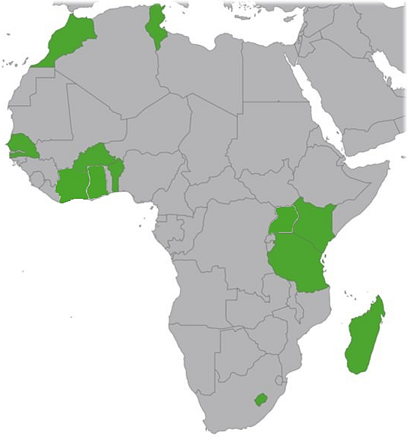
My Experiences in Africa context
Point of View /Observations of my biogas expertise for industrial biogas plant projects in Africa as planner, designer, consultant, Backstopper in the past 20 years.
Today, Not focusing on household/domestic/rural digester who are for cooking and fertilizer for own consumption
3

Slide 4
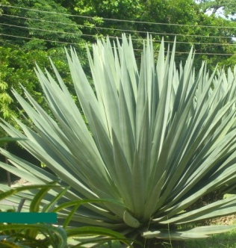
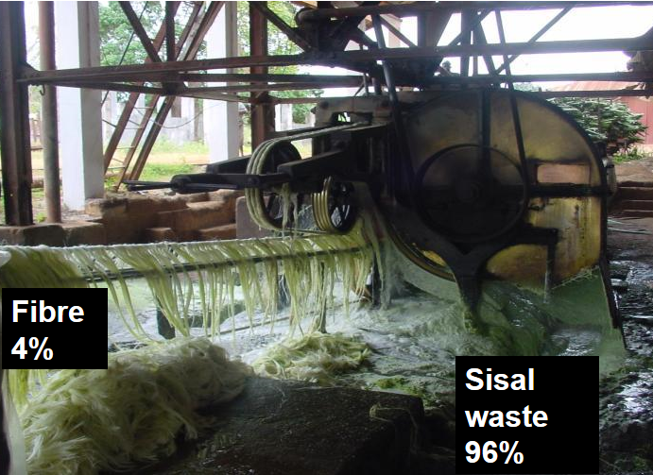
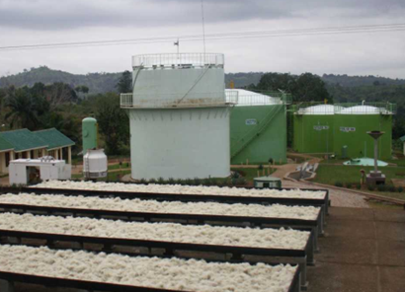
Example of industrial Biogas Plant Sisal Waste from Process Production
Input: 65 m³/d sisalwaste
Parameter: Digester: 2 200 m³ Afterstorage: 1800 m³ CHP: 2 x 180 kW_{ele}

Slide 5
Potential Organic Waste
Large amount of “unused” organic waste available;
Untapped potential for renewable energy solutions;
Challenge on electrical supply, fertilizer or environmental aspects
Classic Organic Waste
“Exotic “Organic Waste
Farm (Cow/pig/Chicken)-waste;
Slaughterhouse;
Bio/Kitchen Waste;
Sewage/wastewater sludge
Jatropha press cake;
Brewery waste;
POME;
Cocao;
Cassava waste;
Flower waste;
Fruit waste ( Pineapple, Mango, Papaya,…)
Water hyacinth;
…
Sisal

Slide 6
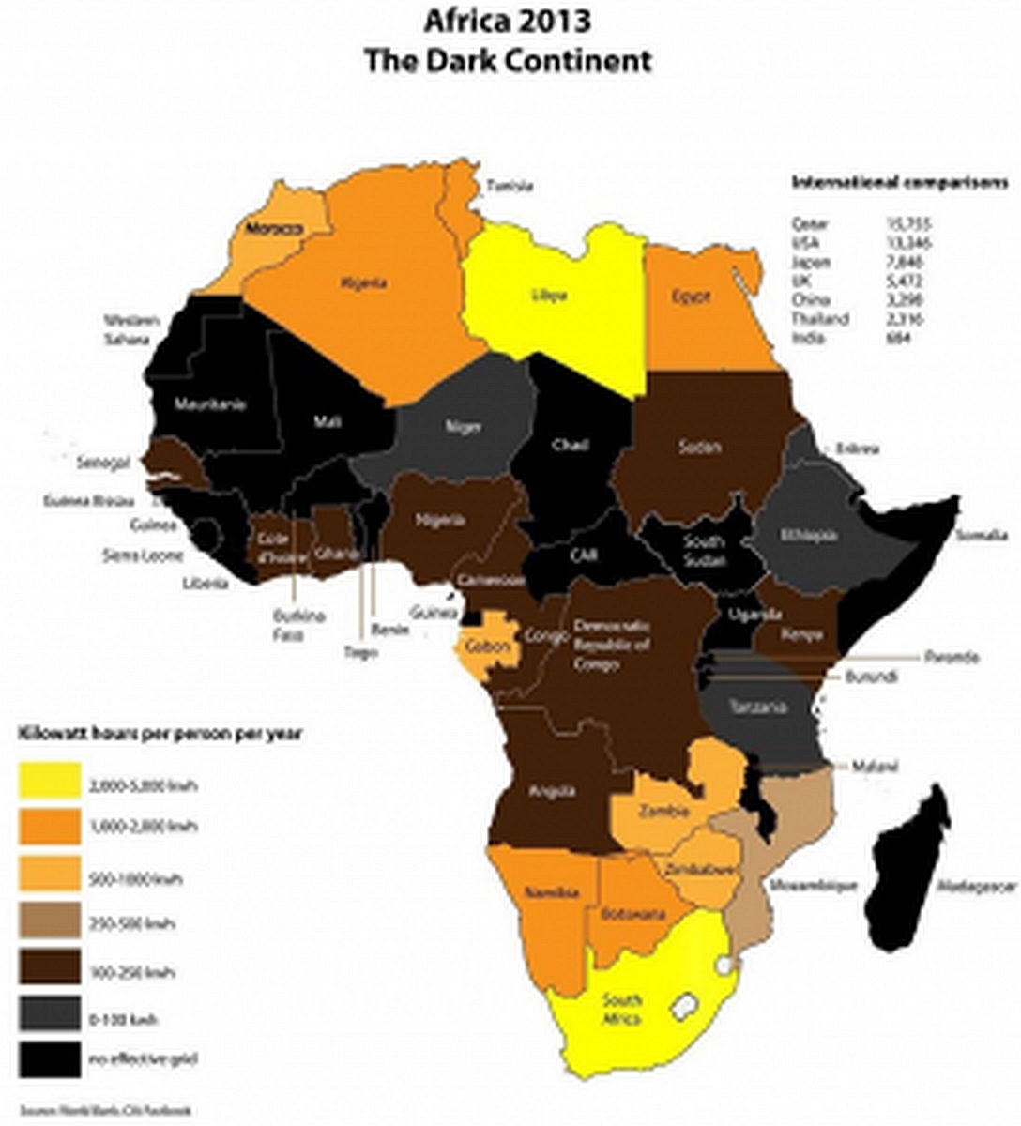
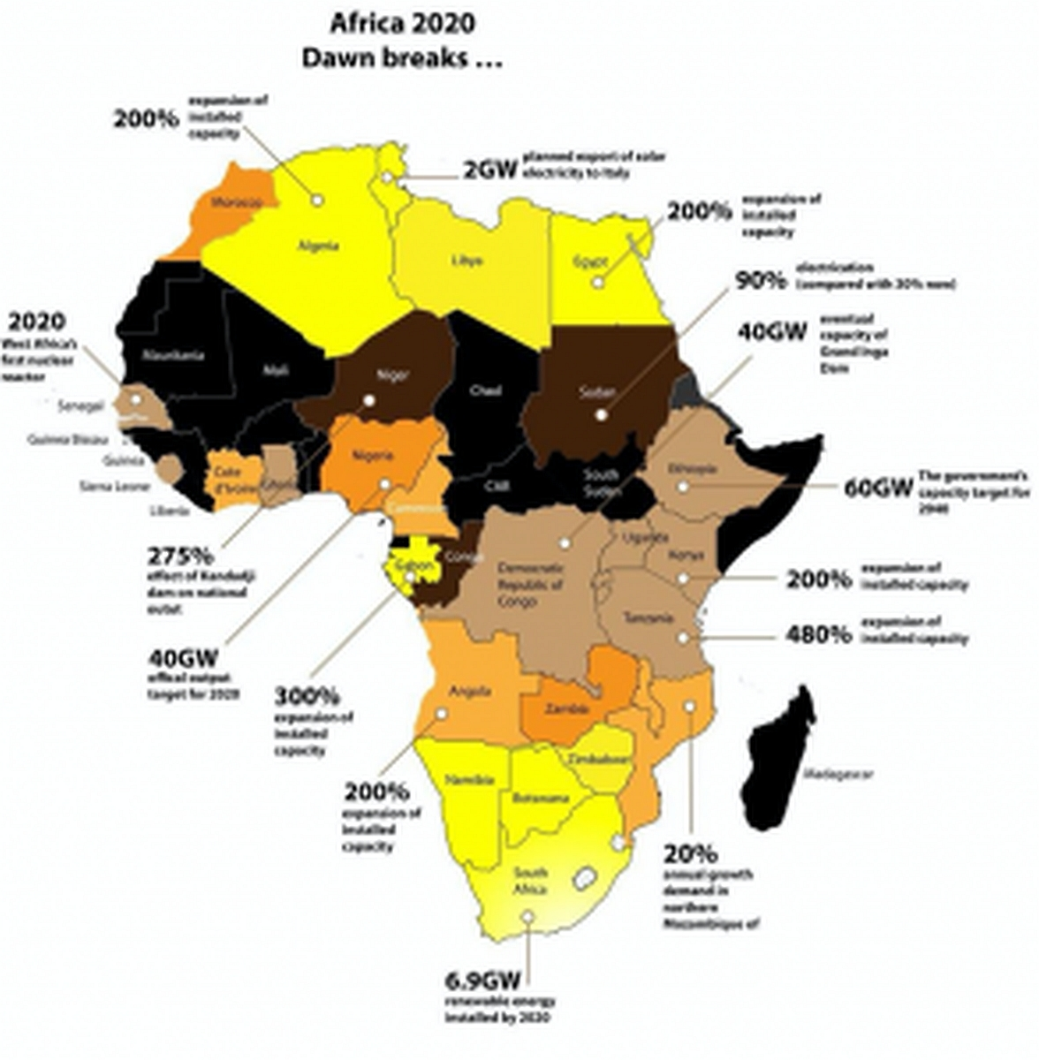
Africa Electricity Consumption Development in a decade
Around 60% of the population resides in rural areas where
there is minimal or no access to electricity (Roopnarain
and Adeleke 2017)
…. Industrial demand increase,
… Population amount increase,
….Biomass not concurrent to other renewable Energy
like wind, solar, hydro, geotherm

Slide 7
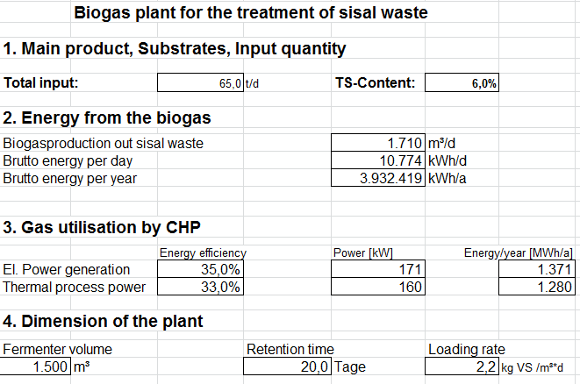
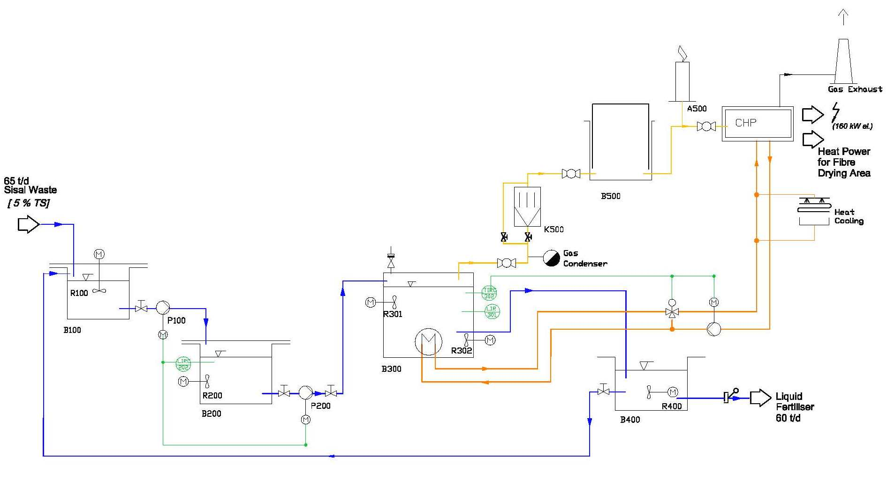
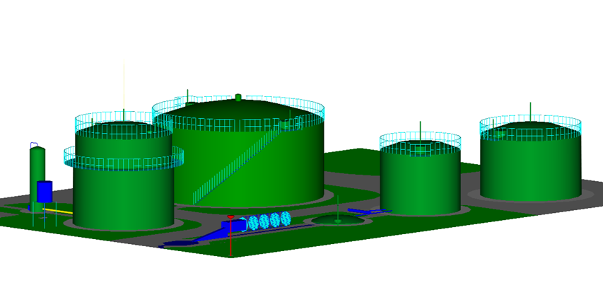
Biogas Plant Engineering
BASIC CALCULATION
PROCESS DESIGN
DRAFT LAYOUT
…. Feasibility Study
….Installation, Supervision, Start-Up
….Commissioning, Training and Hand-over
7

Slide 8
Lessons learned (I)
Funding remains biggest problem:
High capital investment,
poor access to clean energy financing,
very high interest rates on bank loans
Reliable cooperation partners on site / network partners;
Forecasting and anticipating additional activities to plant running:
Long term Co-substrate contract,
Market for fertilizer
Timeline of project implementation;
Less reference of existing industrial plants and experience exchange;
Purchase of equipment on local market more expensive:
Cost trap, Risk cost explosion in construction;

Slide 9
Lessons learned (II)
Hard to find adequate staff and skilled workers and link them to the project:
- Staff turnover very high
Maintenance cycle and facilities management is not optimal;
So far no model comparable to the renewable Energy Act (EEG);
Prioritized decentralized and Power Auto-consumption then difficult negotiations with grid operators
…
In conclusion, several key barriers impede progress
Financial and Economic
Technical and Infrastructural
Market and Awareness

Slide 10
Deduction from the experiences and Rethinking (I) Technology, Process, Economic, and Management Aspects
Extend the assistance and operating over the Hand-over and training period;
Maximizing the possibilities for adding value to the biogas plant's output beside electricity or biomethane (e.g. effluent as fertilizer, heat/cold conversion, Biogas bypass to Worker's camp etc.);
Technology flexibility (Viability of some components), if possible, regional/local suppliers;
Outreach with Keys-players (authorities, associations, etc.) from earlier level to clarify and resolve uncertainties;;
Involvement in discussions with banks and lenders for credit lines;
Provide a framework for local experience exchange; trade fair, workshop;
Prioritized decentralized and self-consumption model due to difficult negotiations with grid operators;
10
Notes:
Concept for effluent as fertilizer

Slide 11
Deduction from the experiences and Rethinking (II) Technology, Process, Economic, and Management Aspects
Prioritized decentralized and self-consumption model due to difficult negotiations with grid operators;
Not single projects, but multiple projects simultaneously;
Implement standard framework for biogasplant through an organization like TÜV, and establish a penalty register;
Build Interdisciplinary team;
…..
11
Notes:
Concept for effluent as fertilizer

Slide 12
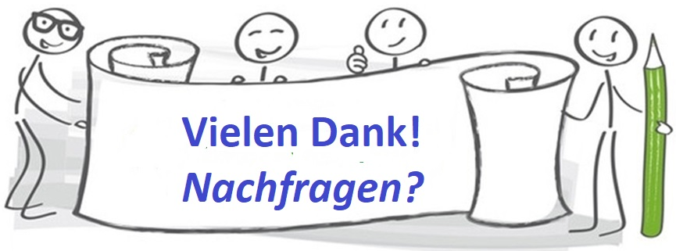
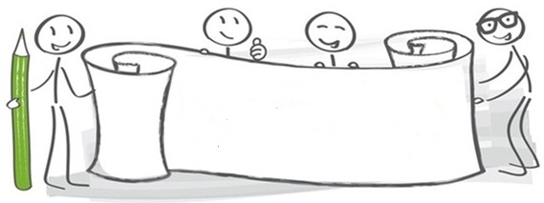
E-Mail: kabenge@htw-berlin.de
g.kabengele@email.de
Skype: g.kabengele
Zoom ID: 270 651 0983

