Slide 1
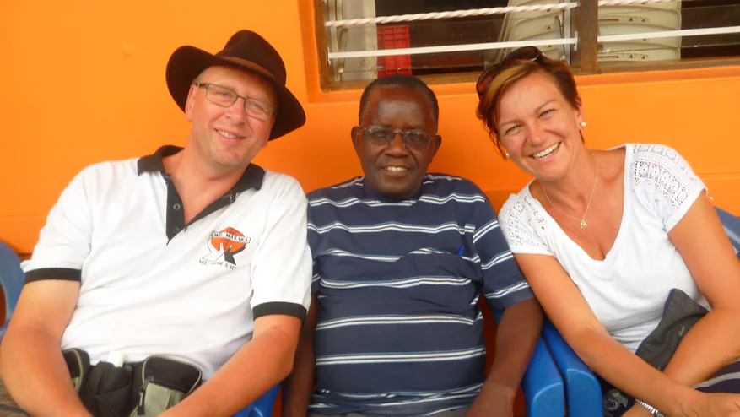
LUK Solar Ltd. Uganda
WORKING FOR A BRIGHTER TOMORROW
LUK Solar Ltd. Kampala/Uganda
[Founded 2025] Kitetikka Ggayaaza Road
P.O Box 102598 Kampala Uganda
Office Kampala +256 (0) 783 893650
email: jude.kigozi@luk-solar.com
homepage: www.luk-solar.com
Kurt Zügner
John Baptist Walusimbi
Lisa Zügner
Our goal is to provide economically disadvantaged people in Uganda
with affordable, reliable, high quality solar technology.

Slide 2
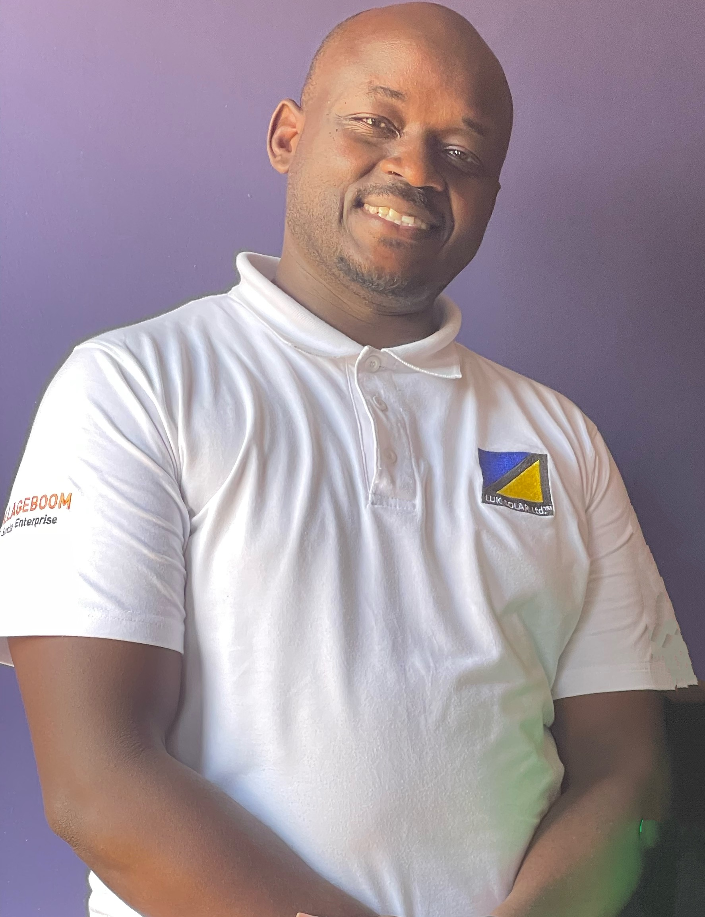
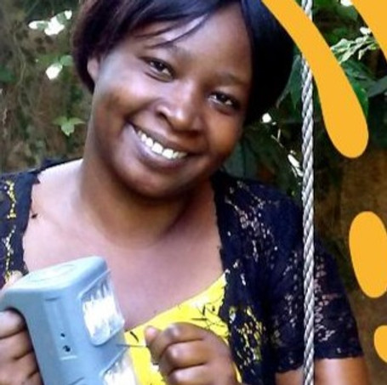
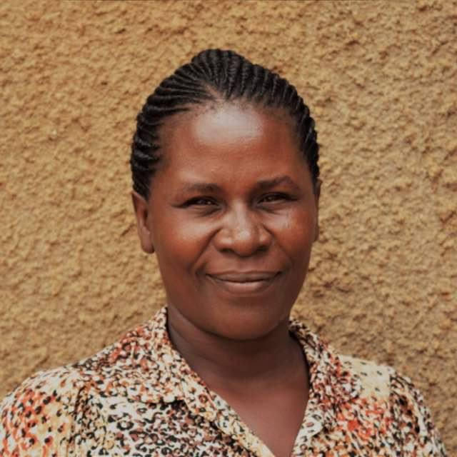
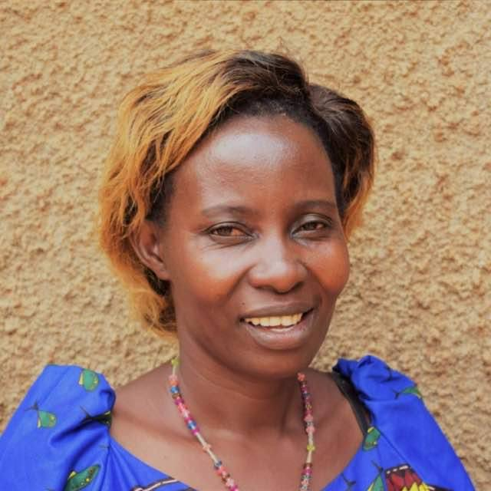
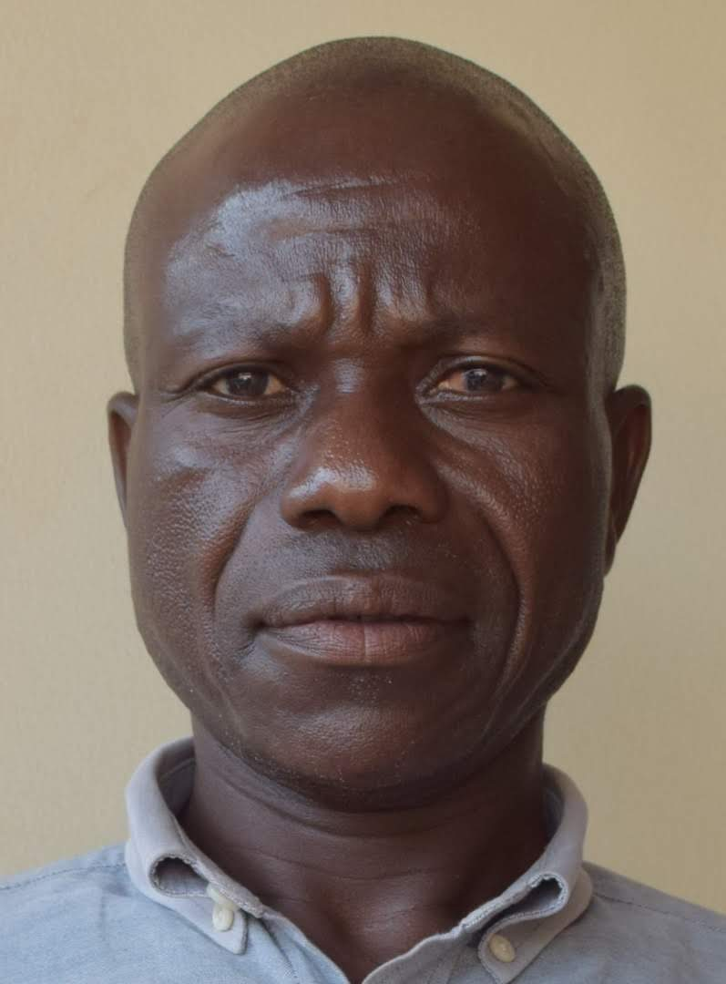
LUK Solar Ltd. Uganda
WORKING FOR A BRIGHTER TOMORROW
Jude Kigozi
Kampala
Managing Director
Brenda
Aleptong
Juliet
Mbale
Jucent
Luweero
Charles
Pakwach
Some of Our Support Team and Solar Sales Technicians (Solar Scouts)

Slide 3
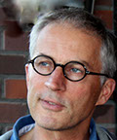
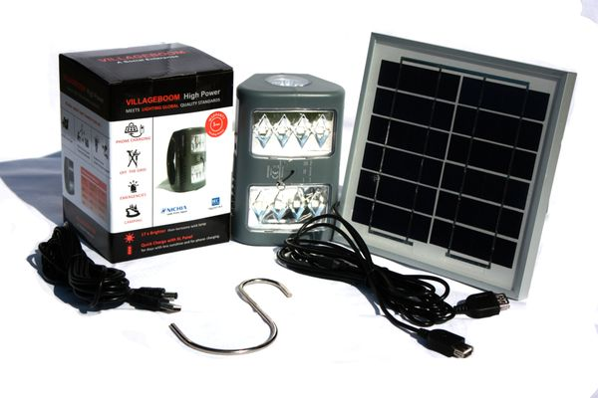
LUK Solar Ltd. Uganda
WORKING FOR A BRIGHTER TOMORROW
Villageboom Thomas Ricke Münster/Germany
High Power + (Designed in Germany)
3 Brightness Settings NICHIA LED Japan 4 W Solar Panel
27x Brighter than Kerosene Lamp 270 Lumen 1 USB + 1 DC output socket
LED Charge Level Indicator
Li-Ion Technology 2x2200mAh 3,7 V
Overcharge/Overdischarge Protection
Flourescent Glowing Pull String Cap
Hook for flexible Lamp Fixture
Our Main partner from Germany (Münster): Villageboom

Slide 4
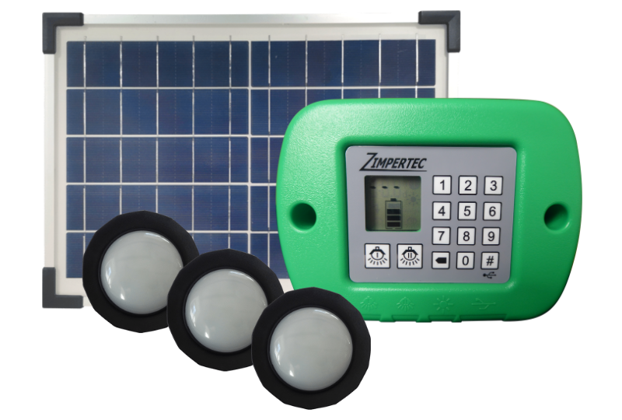
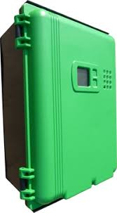
LUK Solar Ltd. Uganda
WORKING FOR A BRIGHTER TOMORROW
Zimpertec GmbH & Co KG /Germany
DC Power Brick 12/24/36 Wh [PayGo]
3.2 V SHS kit for 2-3 lamps and phone charging
DC LSX Solar Home System 98Wh -294 Wh [PayGo]
12 V DC SHS lamps, phone, fans, radio, laptop and TV
DC SHS Solar Home System 25-50 320Wh/640 Wh [PayGo]
12 V DC SHS lamps, phone, fans, radio, laptop, TV and fridges

Slide 5
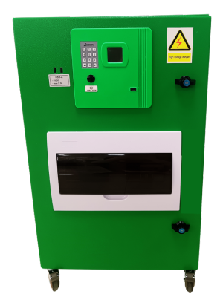
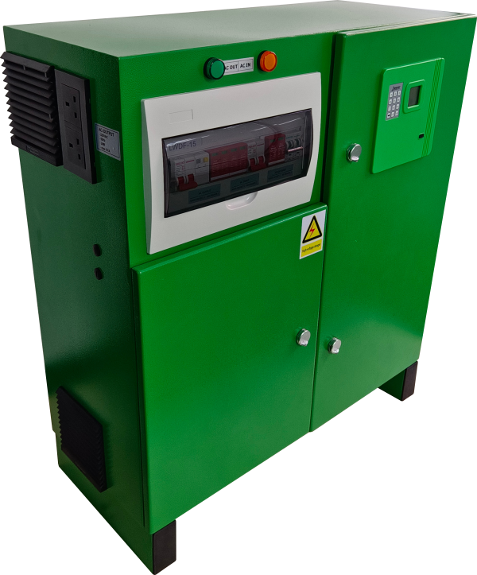
LUK Solar Ltd. Uganda
WORKING FOR A BRIGHTER TOMORROW
Zimpertec GmbH & Co KG /Germany
LS AC 900 0.9 kW/1.28 kWh [PayGo]
110/220V AC smaller shops, offices, health stations for basis applications
LS AC 2 kW 2.0 kW/5.12 kWh [PayGo]
110/220V AC shops, offices, medical centers
Our Main partner from Germany: Zimpertec GmbH & Co. KG

Slide 6
LUK Solar Ltd. Uganda
WORKING FOR A BRIGHTER TOMORROW
In order to experience the benefits of bright solar light, we have initiated and piloted and mastered the Solar Light Women Group Savings Campaign since 2015, which is exclusively to savings and credit groups which meet frequently.
​Every participating women group will receive the following offer:
Each group member will receive a bright solar light (Villageboom High Power Plus) for a free trial
period of two weeks. After this period, you can decide for or against
In case a group member is interested to buy the solar lamp, she has the option to buy it in installments
of 5,000 UGX per week x 28 weeks = 140,000 UGX
2-year warranty
Comprehensive after sales service which ensures that all mobile phones of the household can be charged
and that each lamp works every day. In case a lamp does not work, a temporary replacement solar lamp
is provided during the time of repair.

Slide 7
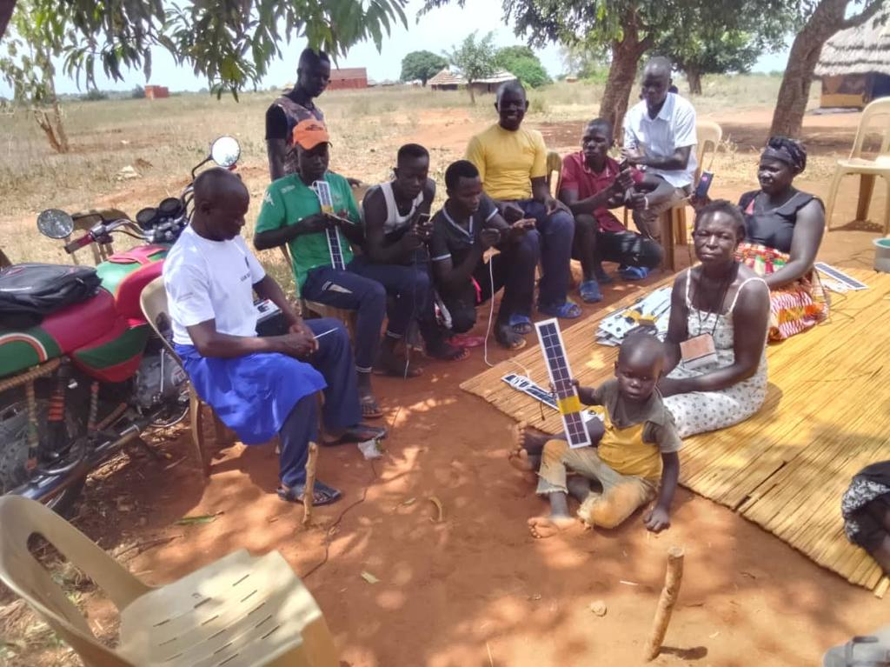
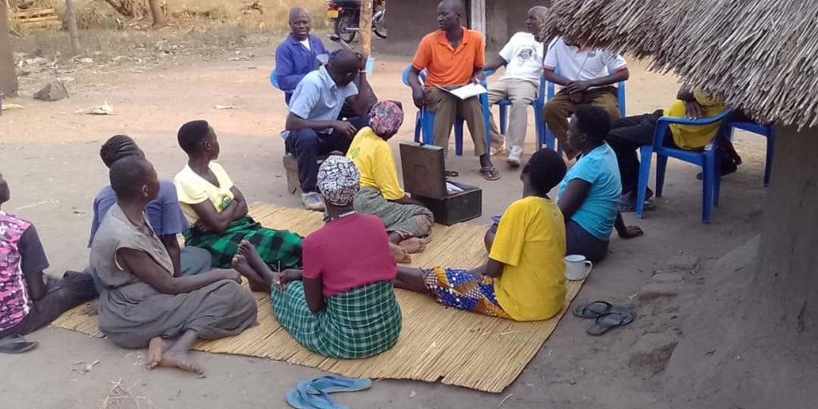
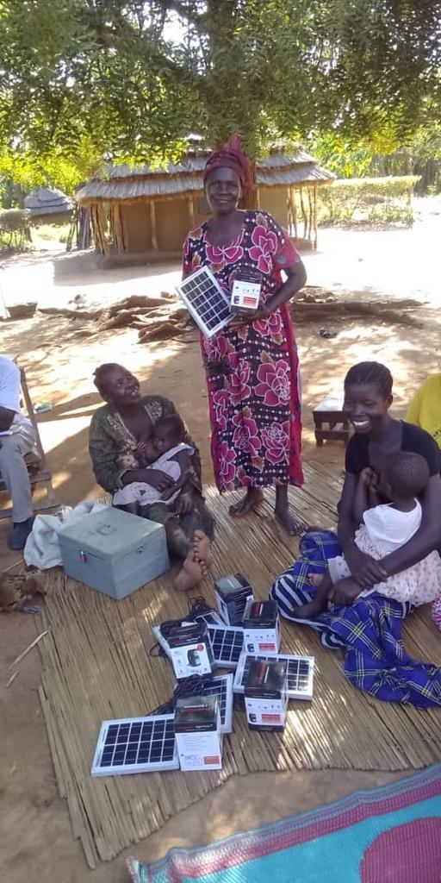
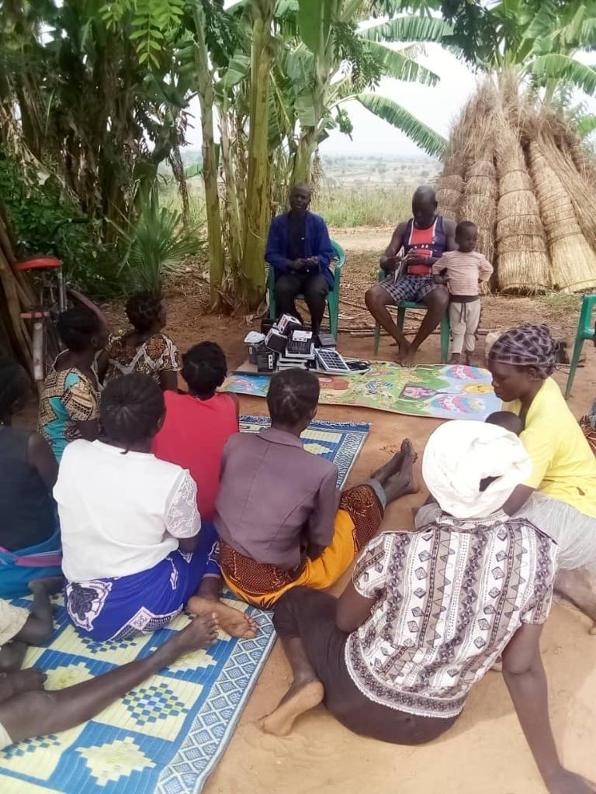
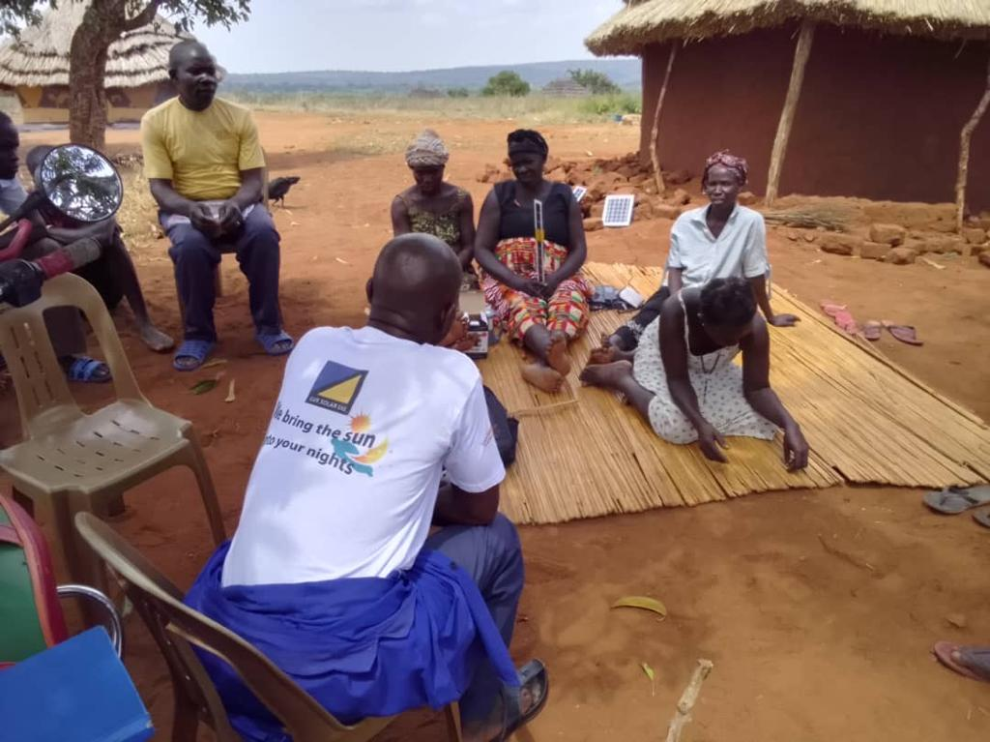
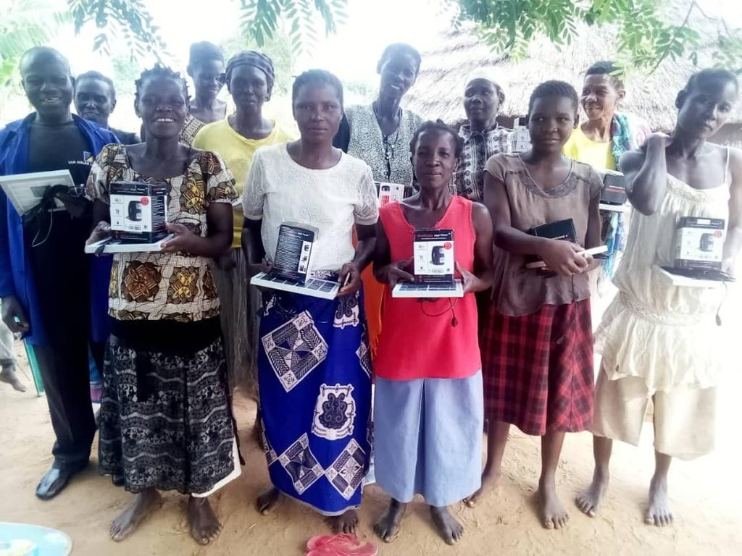
LUK Solar Ltd. Uganda
WORKING FOR A BRIGHTER TOMORROW

Slide 8
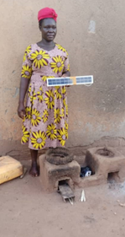
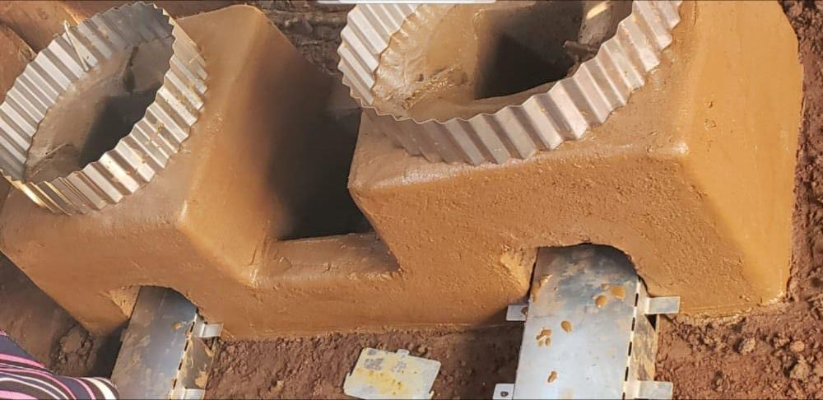
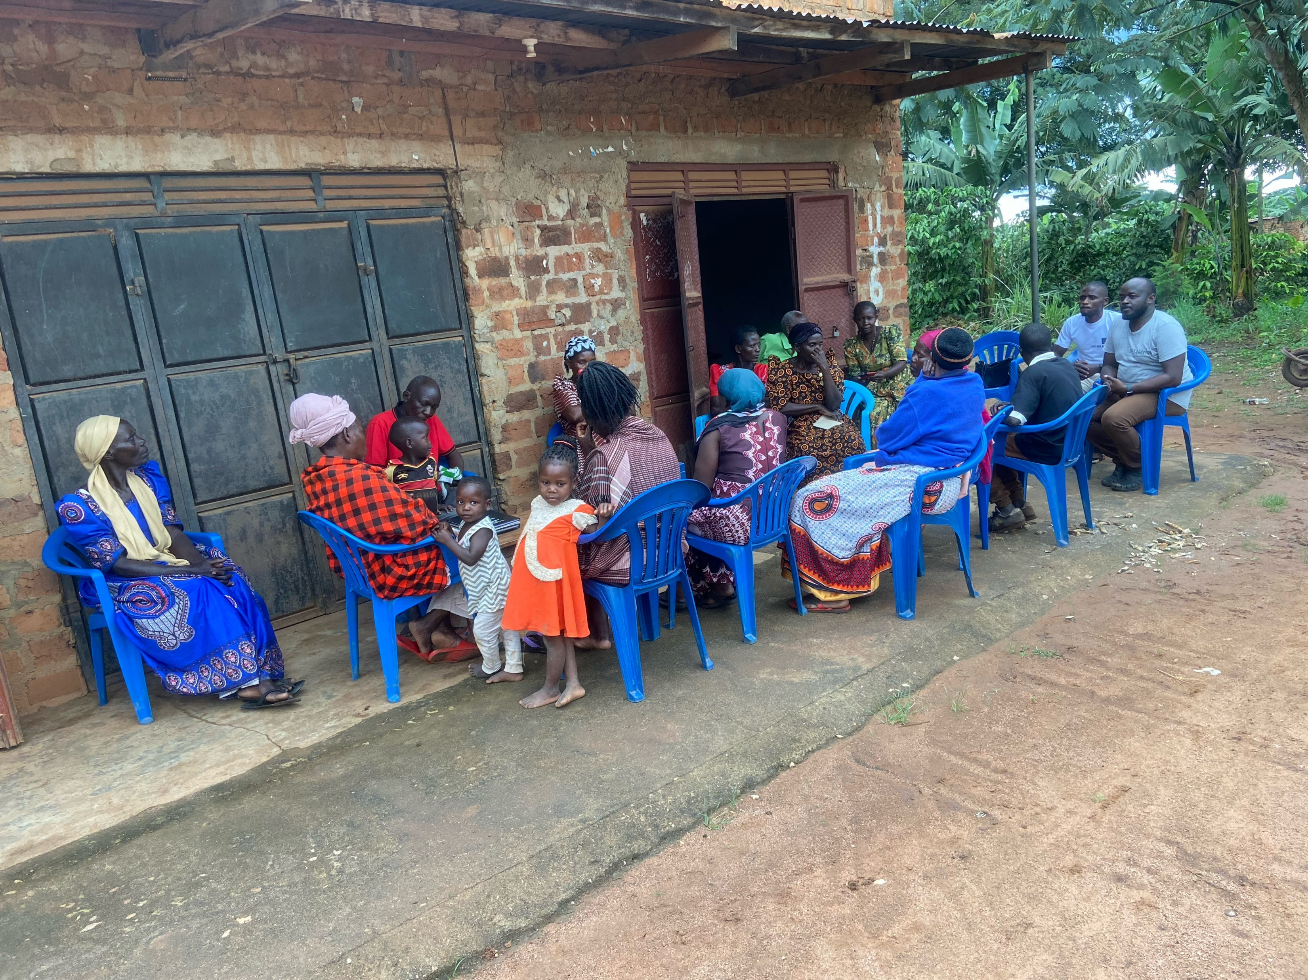
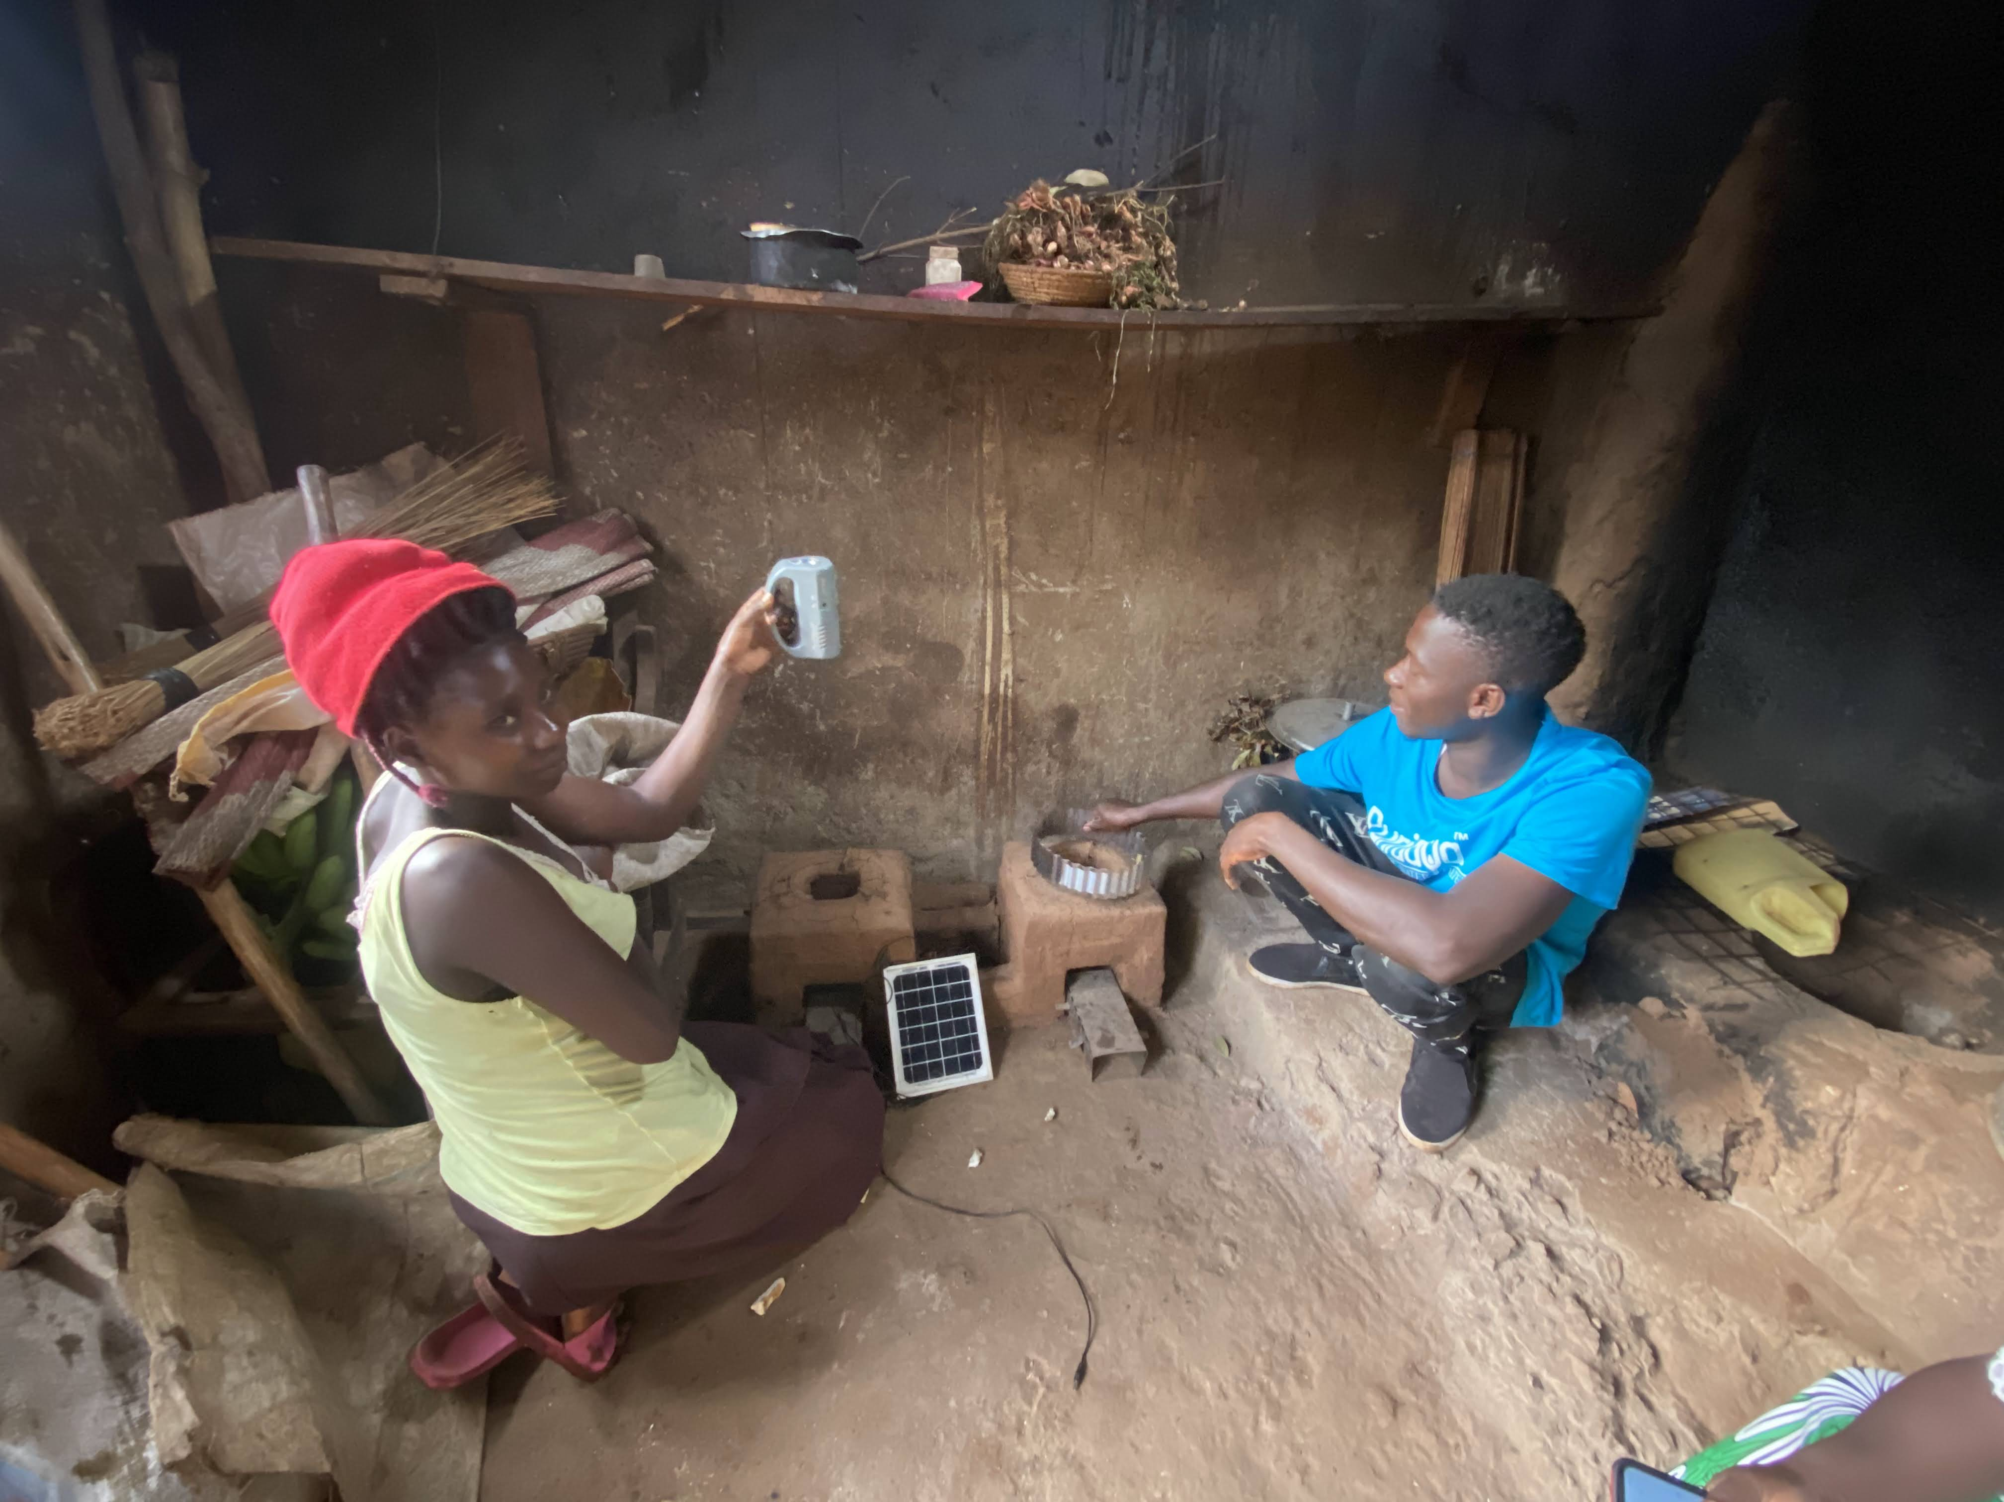
LUK Solar Ltd. Uganda
WORKING FOR A BRIGHTER TOMORROW
Collective Firewood Collection
- Combination with firewood collection and improved cooking stoves
- Strategy: Create a market for firewood within each women group
- Safe money with using hand made cooking stove
- Testing Area: Region Luweero

Slide 9
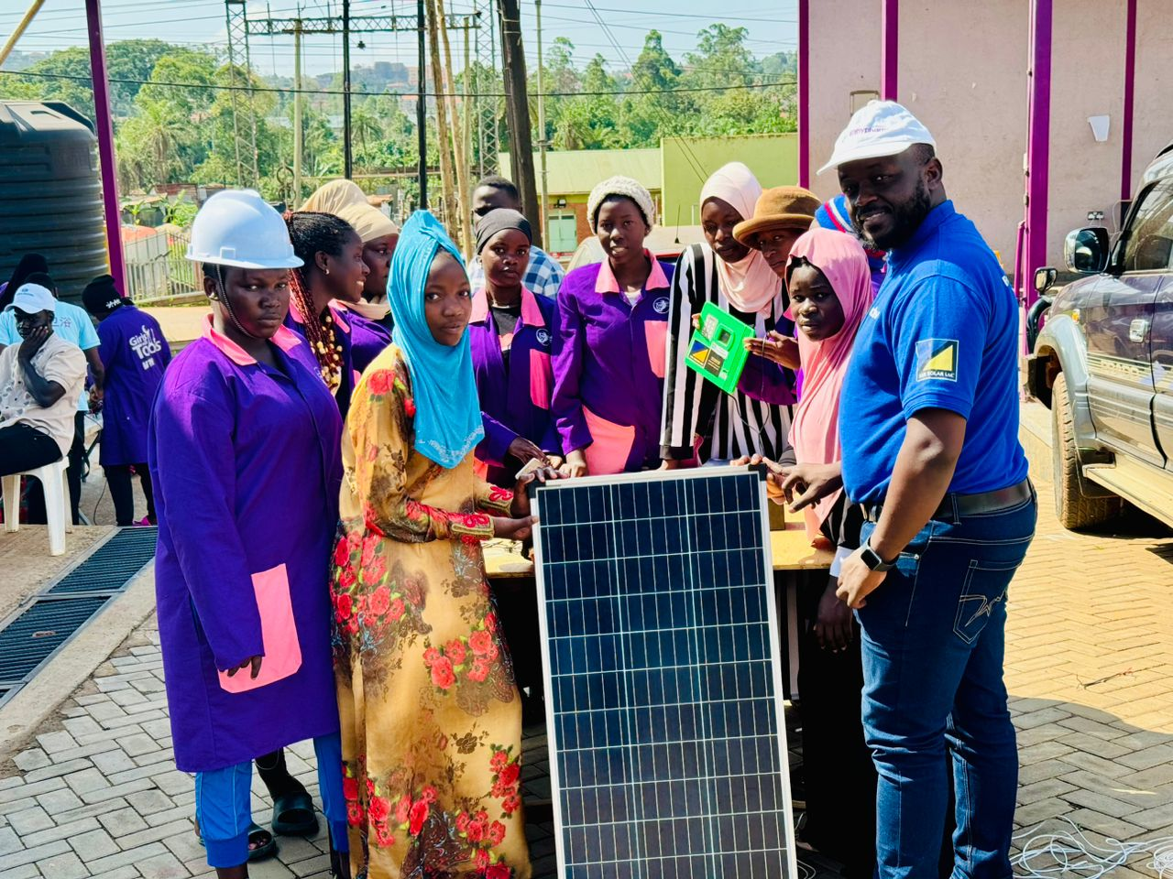
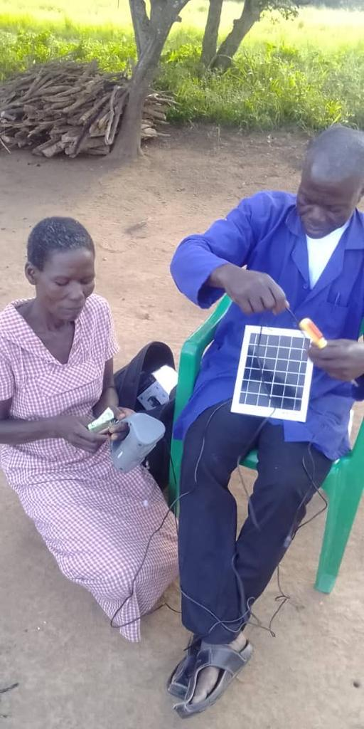
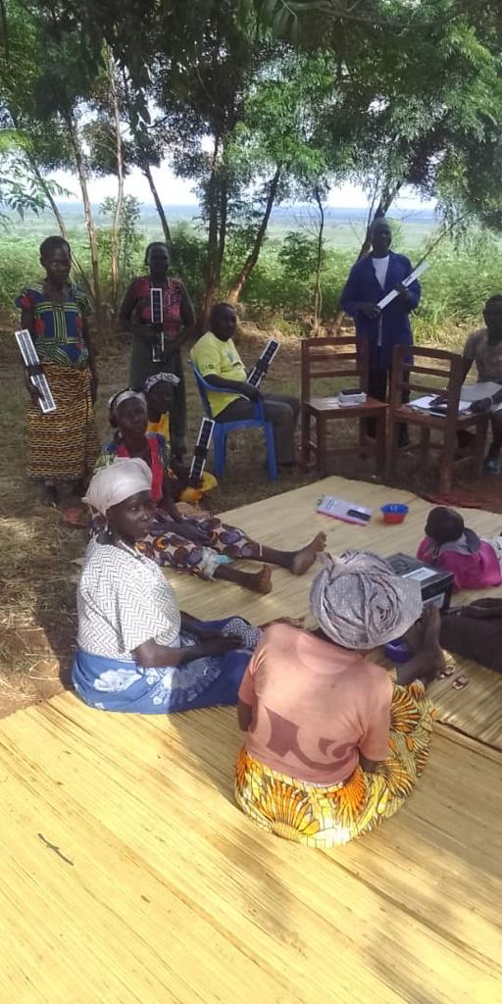
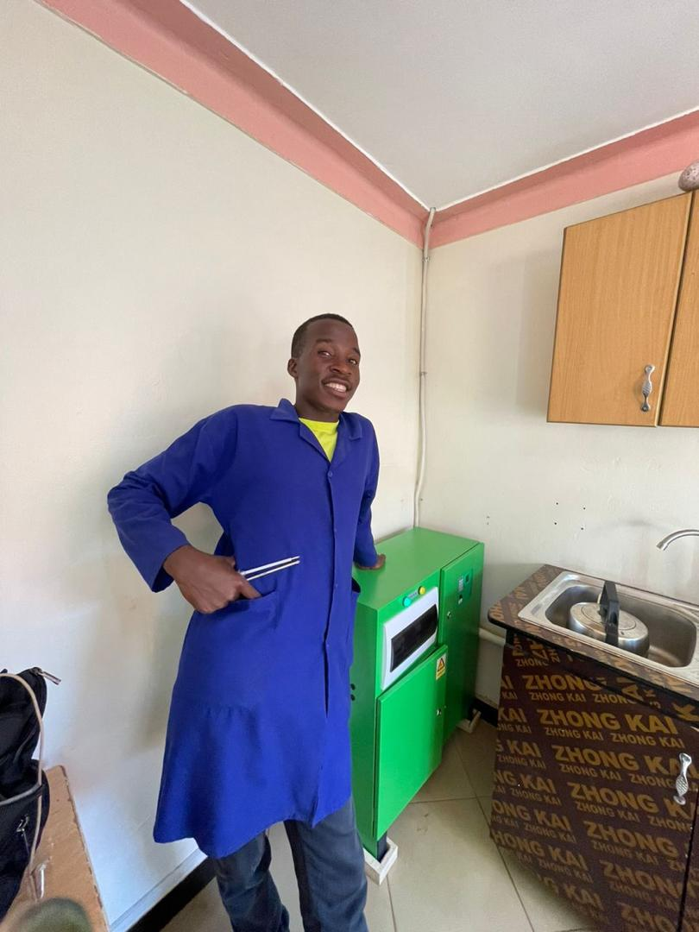
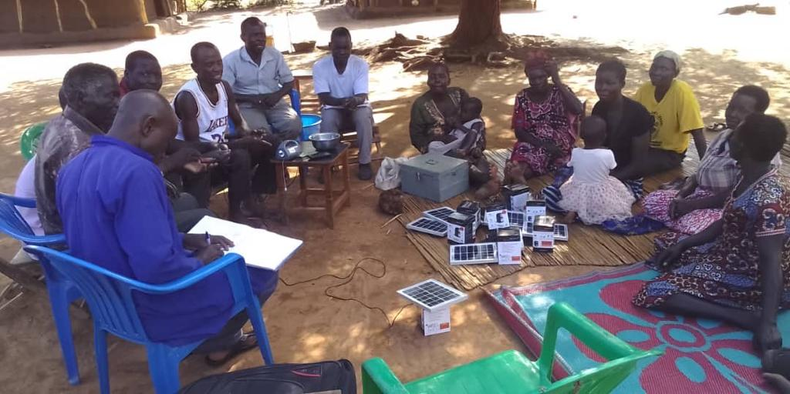
intermediate life cycle
LUK Solar Ltd. Uganda
WORKING FOR A BRIGHTER TOMORROW
The LUK Solar Maintenance Service Team for the after sales management
- After Sales Service Team istall in every Sales region
-Warranty Villageboom Systems: 2 Years
-Zimpertec DC SHS Systems: 3 Years
-Service Batterie Exchangeservice (recyling process)
-intermediate live cyclus Villageboom lamps: 6 years

Slide 10
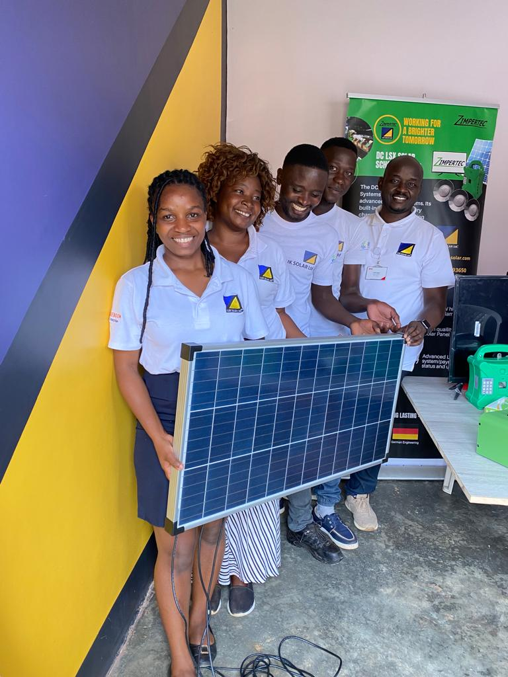
LUK Solar Ltd. Uganda
WORKING FOR A BRIGHTER TOMORROW
How many Lamps in a year
2021/2022 = 25,600
2022/2023 = 19,830
2023/2024 = 29,840
How much money we collected
2021/2022 = Ugx 166.400.000
2022/2023 = Ugx 193.895.000
2023/2024 = Ugx 568.895.000
Cooperation with donation programs;
UECCC WorldBank Project (13,000 Lamps)
GiZ/Endev Refugee program (2,000 Lamps)
EEP, Villageboom Commitment (40,000 Lamps)
GIZ, Schools Program (289 Schools)
Our Partners:
Fa. Villageboom (Thomas Ricke)
Fa. Zimpertec (Ulrich Zimmermann)
Regions where we work with solar agent Staff:
Luweero
Obongi
Lamwo
Pakwach
Nebbi
Alebtong
Terego
Bwera
Bussi island
Kayunga
Adjumani
Busia
Mbale
Kitgum
Soroti

Slide 11
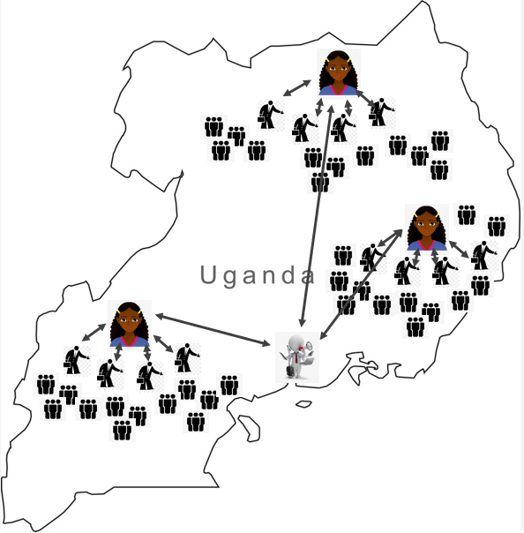
LUK Solar Ltd. Uganda
WORKING FOR A BRIGHTER TOMORROW
Sales Structure of 3 levels:
Management, located in Kampala
Solar Scouts (Agents)
Employees who are Business partner as entrepreneurs in Solar
Solar groups Manager
Social Group leaders (representatives)

Slide 12
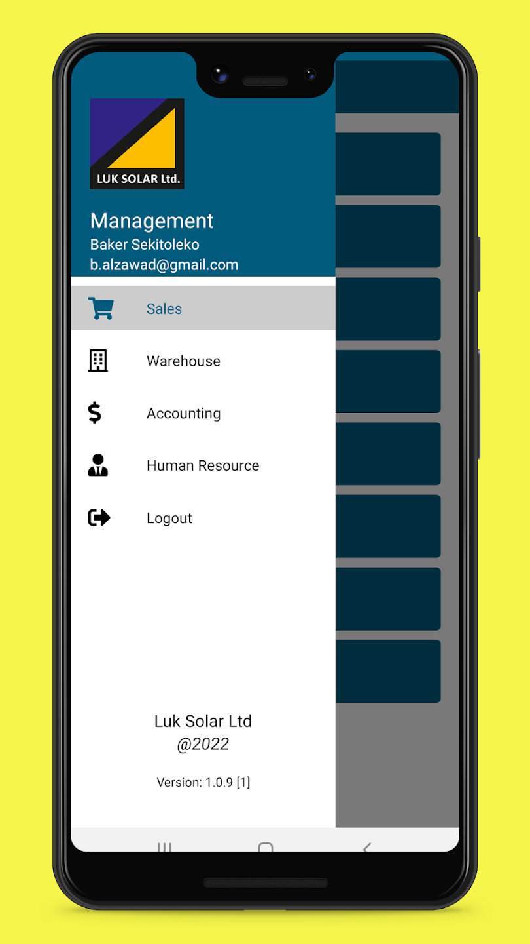
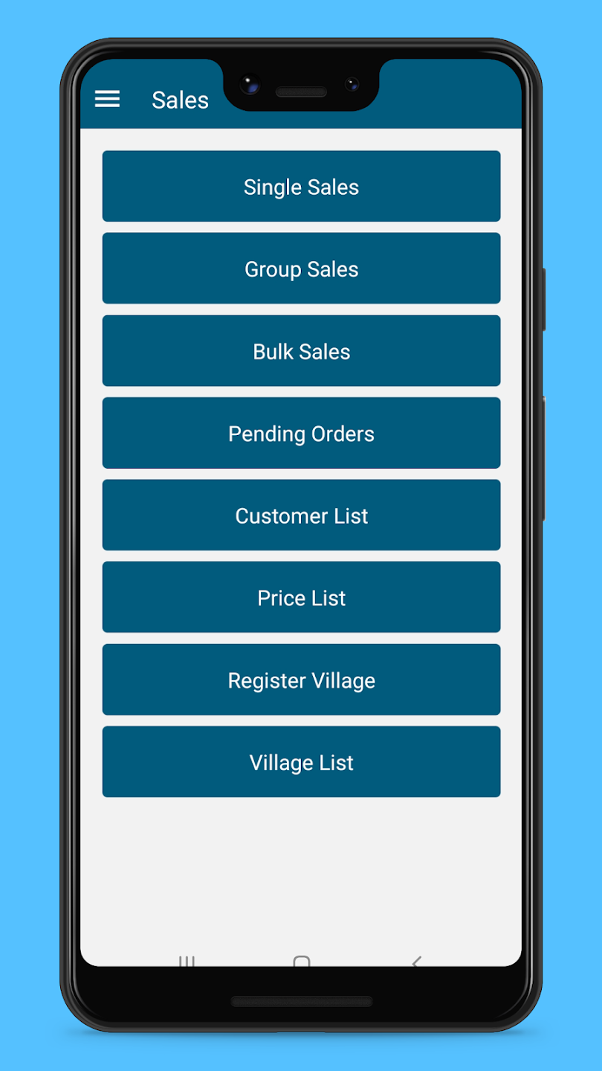
LUK Solar Ltd. Uganda
WORKING FOR A BRIGHTER TOMORROW
APP BASED BUSINESS SOLUTIONS (ABBS):
Registering a solar lamp group
Order solar lamps from the main stock in Kampala
Transport the lamps with bus lines
Confirmation of receipt of local stock
Handing over the lamps to the group
Assignment of customer to each lamp
Weekly payments to the group manager
Transferring funds via mobile money
Monthly payment of commissions via mobile money

Slide 13
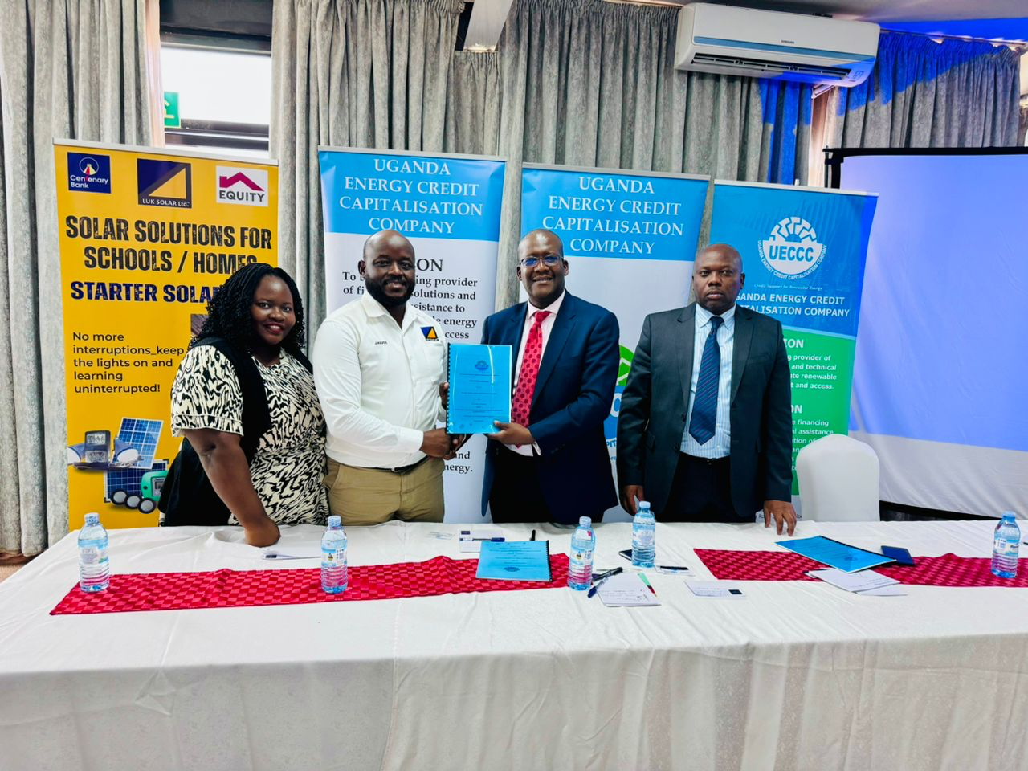
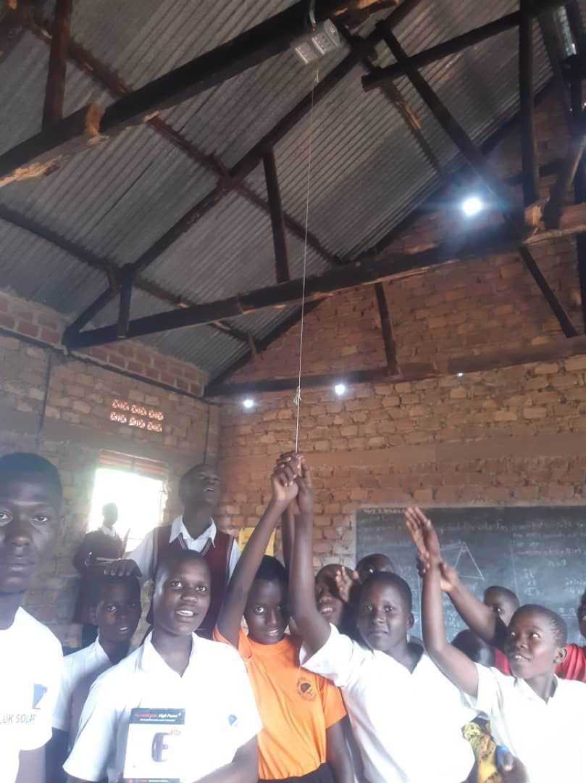
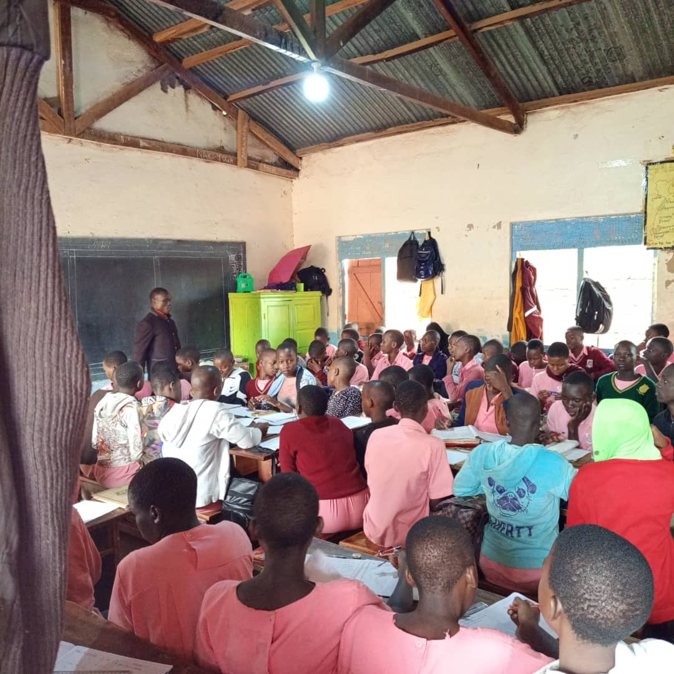
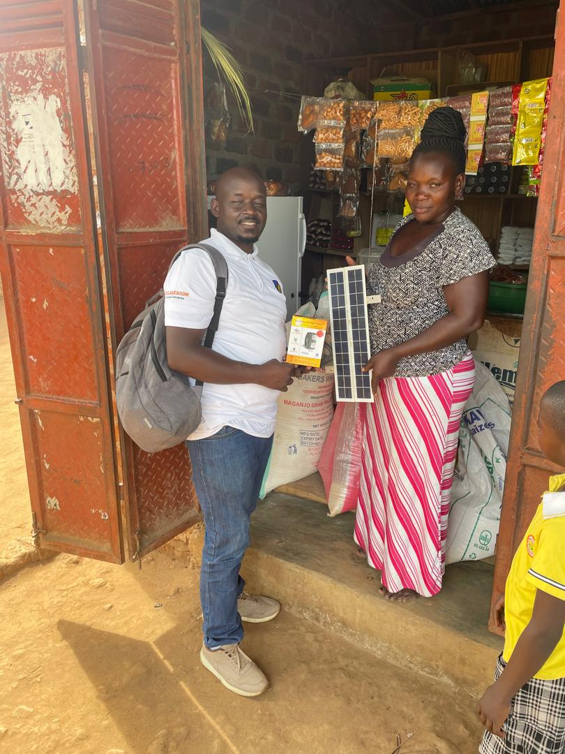
LUK Solar Ltd. Uganda
WORKING FOR A BRIGHTER TOMORROW
Solar Schools Lighting with GIZ – Endev
GIZ EnDev Uganda worked with us as partners for the performance- and market-based distribution of solar systems for phone charging and lighting school classrooms as cost-efficient solution for learning and studying after nightfall, as well as for lighting of dormitories, staff houses and for security purposes. A total of 289 were installed
World bank EASP programmes
World Bank Project: UECCC which is a government of Uganda project has contracted LUK solar Ltd and we shall sell over 13,000 ShS under this project in 24 months.
Notes:
Overview of the business plan for the World bank RBF:
LUK Solar Ltd in Uganda, has successfully been contracted by the government of Uganda’s; Uganda Energy Credit Capitalization Company under the Energy Access Strengthening Project subsidy program. And Since November 2024 we are providing the above solar products to all the people of Uganda who are paying a fee discounted at 60% by the World bank funding in order to afford access to clean cooking and clean solar electricity. This means that for each sale made, a guaranteed 60% payment is made by the UECCC to LUK solar’s bank account. This is the same guarantee which we will extend to secure the repayments for the requested loan of euro 500,000 for inventory financing. The remaining 40% from the sales proceed, which we shall generate directly from the end user customers for the solar home systems and proceeds from the improved clean cooking systems will meet the remaining capital and overhead expenses for the day to day operations of LUK solar with a budgeted net income of 10%
2. GiZ EnDev Uganda worked with us for 12 months for consultancy services for the sale, distribution and after-sales service for solar systems in schools. The window was open from 2nd August 2022 to August 2023.
In Uganda, EnDev collaborates with the Ministry of Energy and Mineral Development in providing support to solar distributors to facilitate access to modern energy services for households, social institutions, and small and medium enterprises.
Objective
EnDev Uganda worked with partners for the performance- and market-based distribution of solar systems for phone charging and lighting school classrooms as cost-efficient solution for learning and studying after nightfall, as well as for lighting of dormitories, staff houses and for security purposes. Furthermore, awareness among teachers, students and parents about the benefits of solar systems shall be increased.

Slide 14
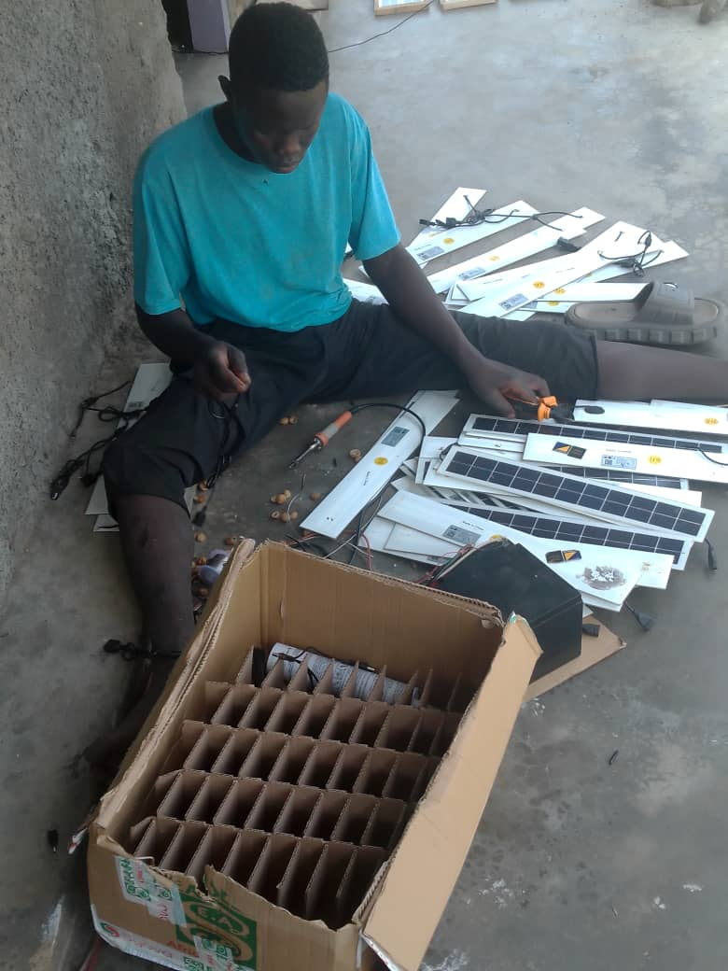
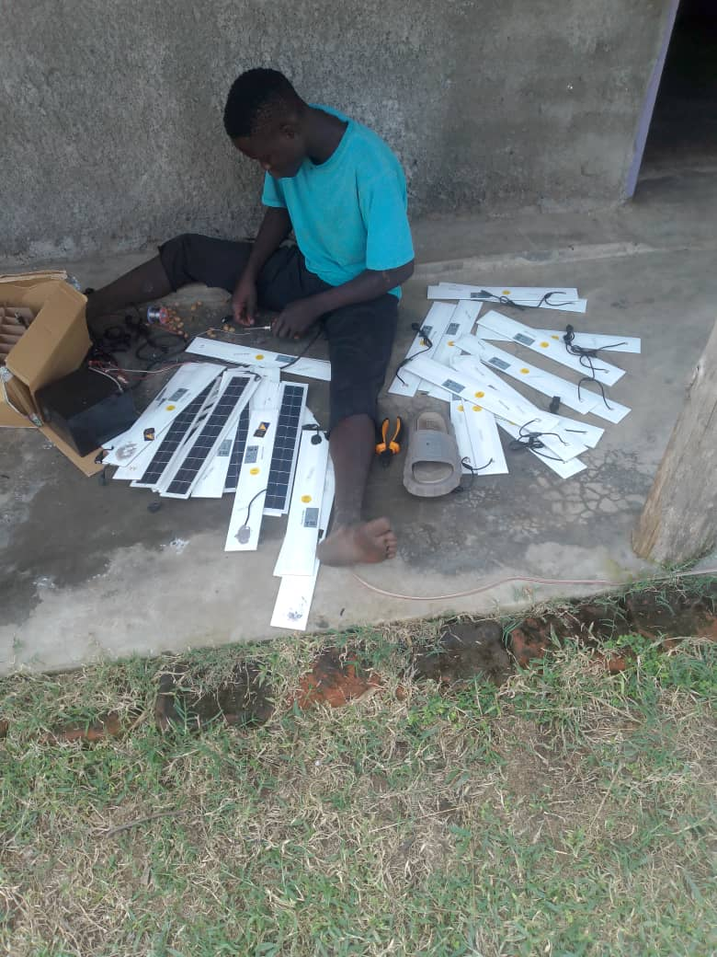
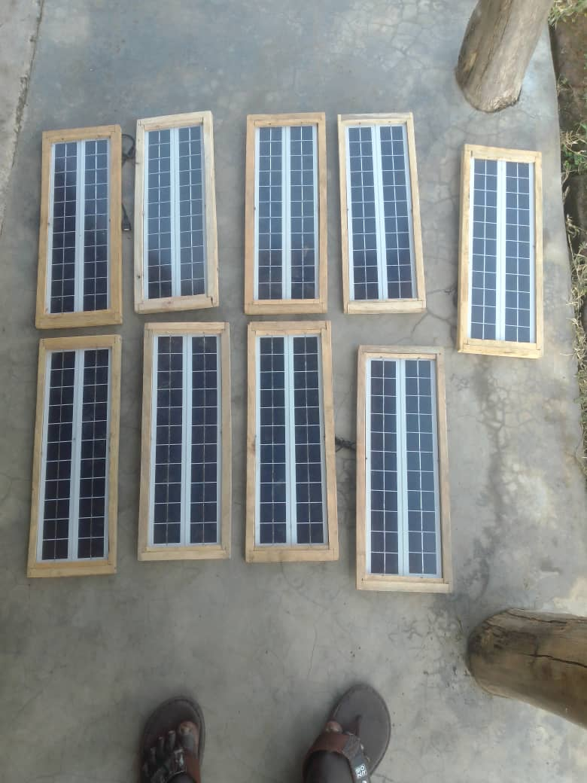
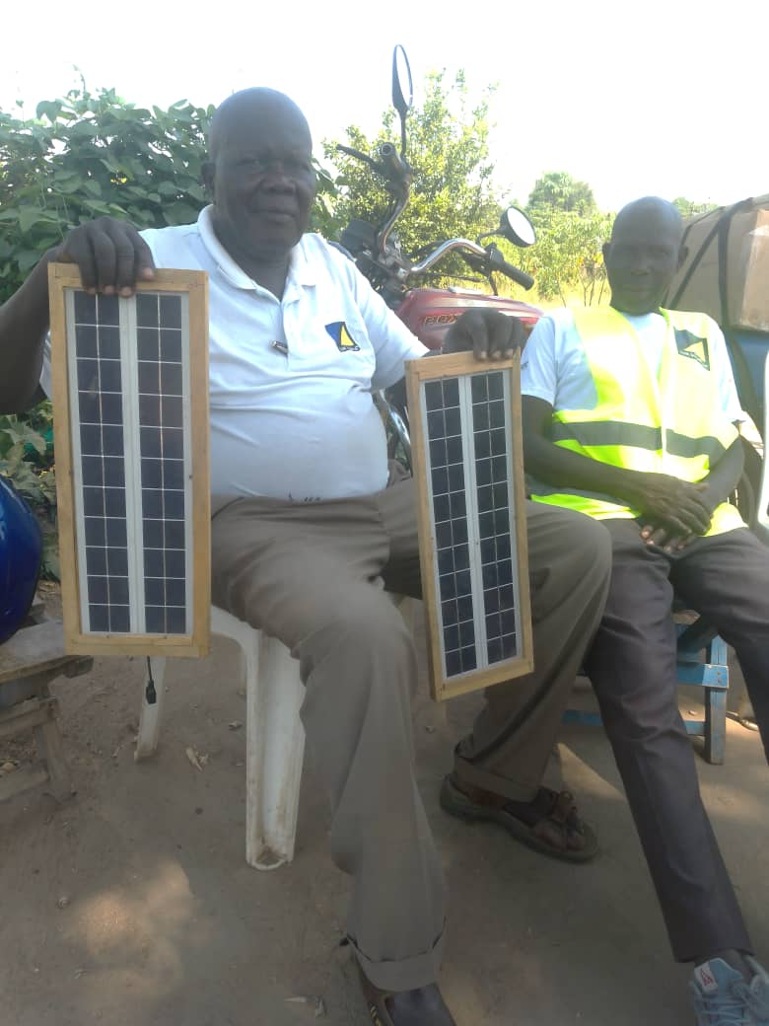
LUK Solar Ltd. Uganda
WORKING FOR A BRIGHTER TOMORROW
Next Developments: I. PV Modules Production
-Puchase of PV cells from a German Compagny
-Manual soldering of the Cells to 10 W Moduls
-Assembling an alluminium or wood frame and attaching the connection Cables
- Production Target is 10.000 PV Moduls per year
- Selling the 10 Watt Modules to customers for charging Phones
Notes:
Production target 10,000 PV 10 watt modules per year

Slide 15
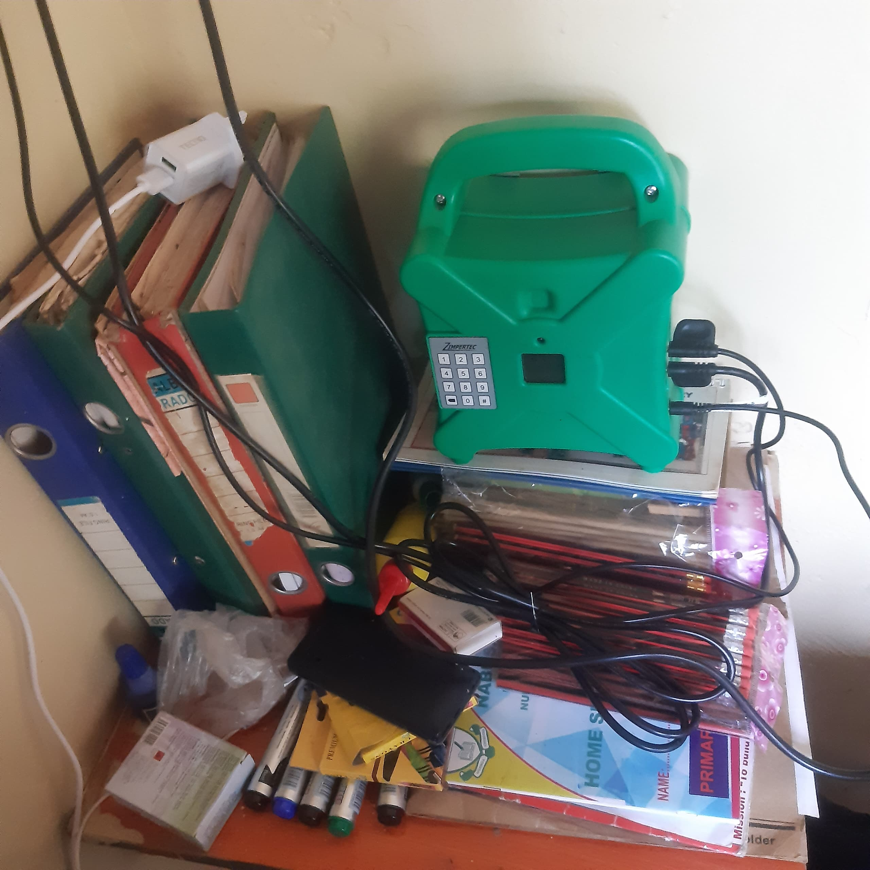
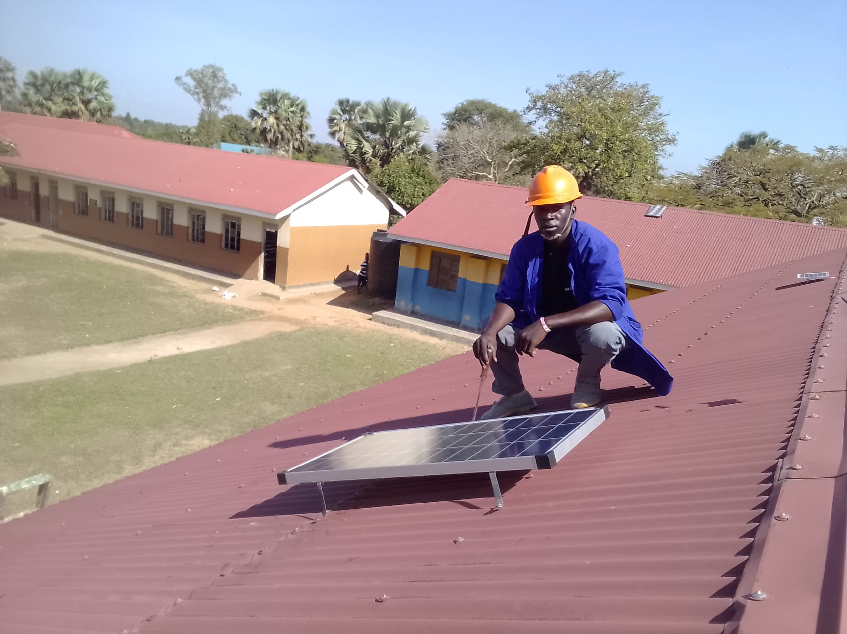
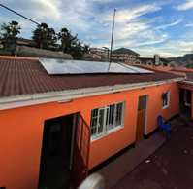
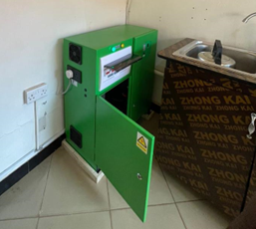
LUK Solar Ltd. Uganda
WORKING FOR A BRIGHTER TOMORROW
Next Developments: II. PV Systems for Heathscenters and Schools
- Work with the UECCC project to power more businesses
Healthcentres and Schools with Productive Use of Energy Solar Products like Solar
Freezers and AC Solar School Systems.
We are inviting a suitable partner for Inventory Financing to power this next step of
Productive Use of Solar Energy .

Slide 16
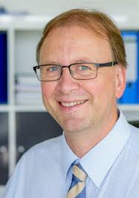
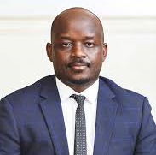
LUK Solar Ltd. Uganda
WORKING FOR A BRIGHTER TOMORROW
“We as LUK Solar Ltd. believes in a basis of trust for any kind of business. We want to make Solar Light available for EVERYONE in Uganda.”
Dipl. Ing. (FH) Kurt Zügner Judo Kigozi E-Mail: info@luk-solar.com
homepage: www.luk-solar.com

